Slide 1

1:
Splash screen background

Slide 2

2:
Possible screen 1 with intro text and logo

Slide 3
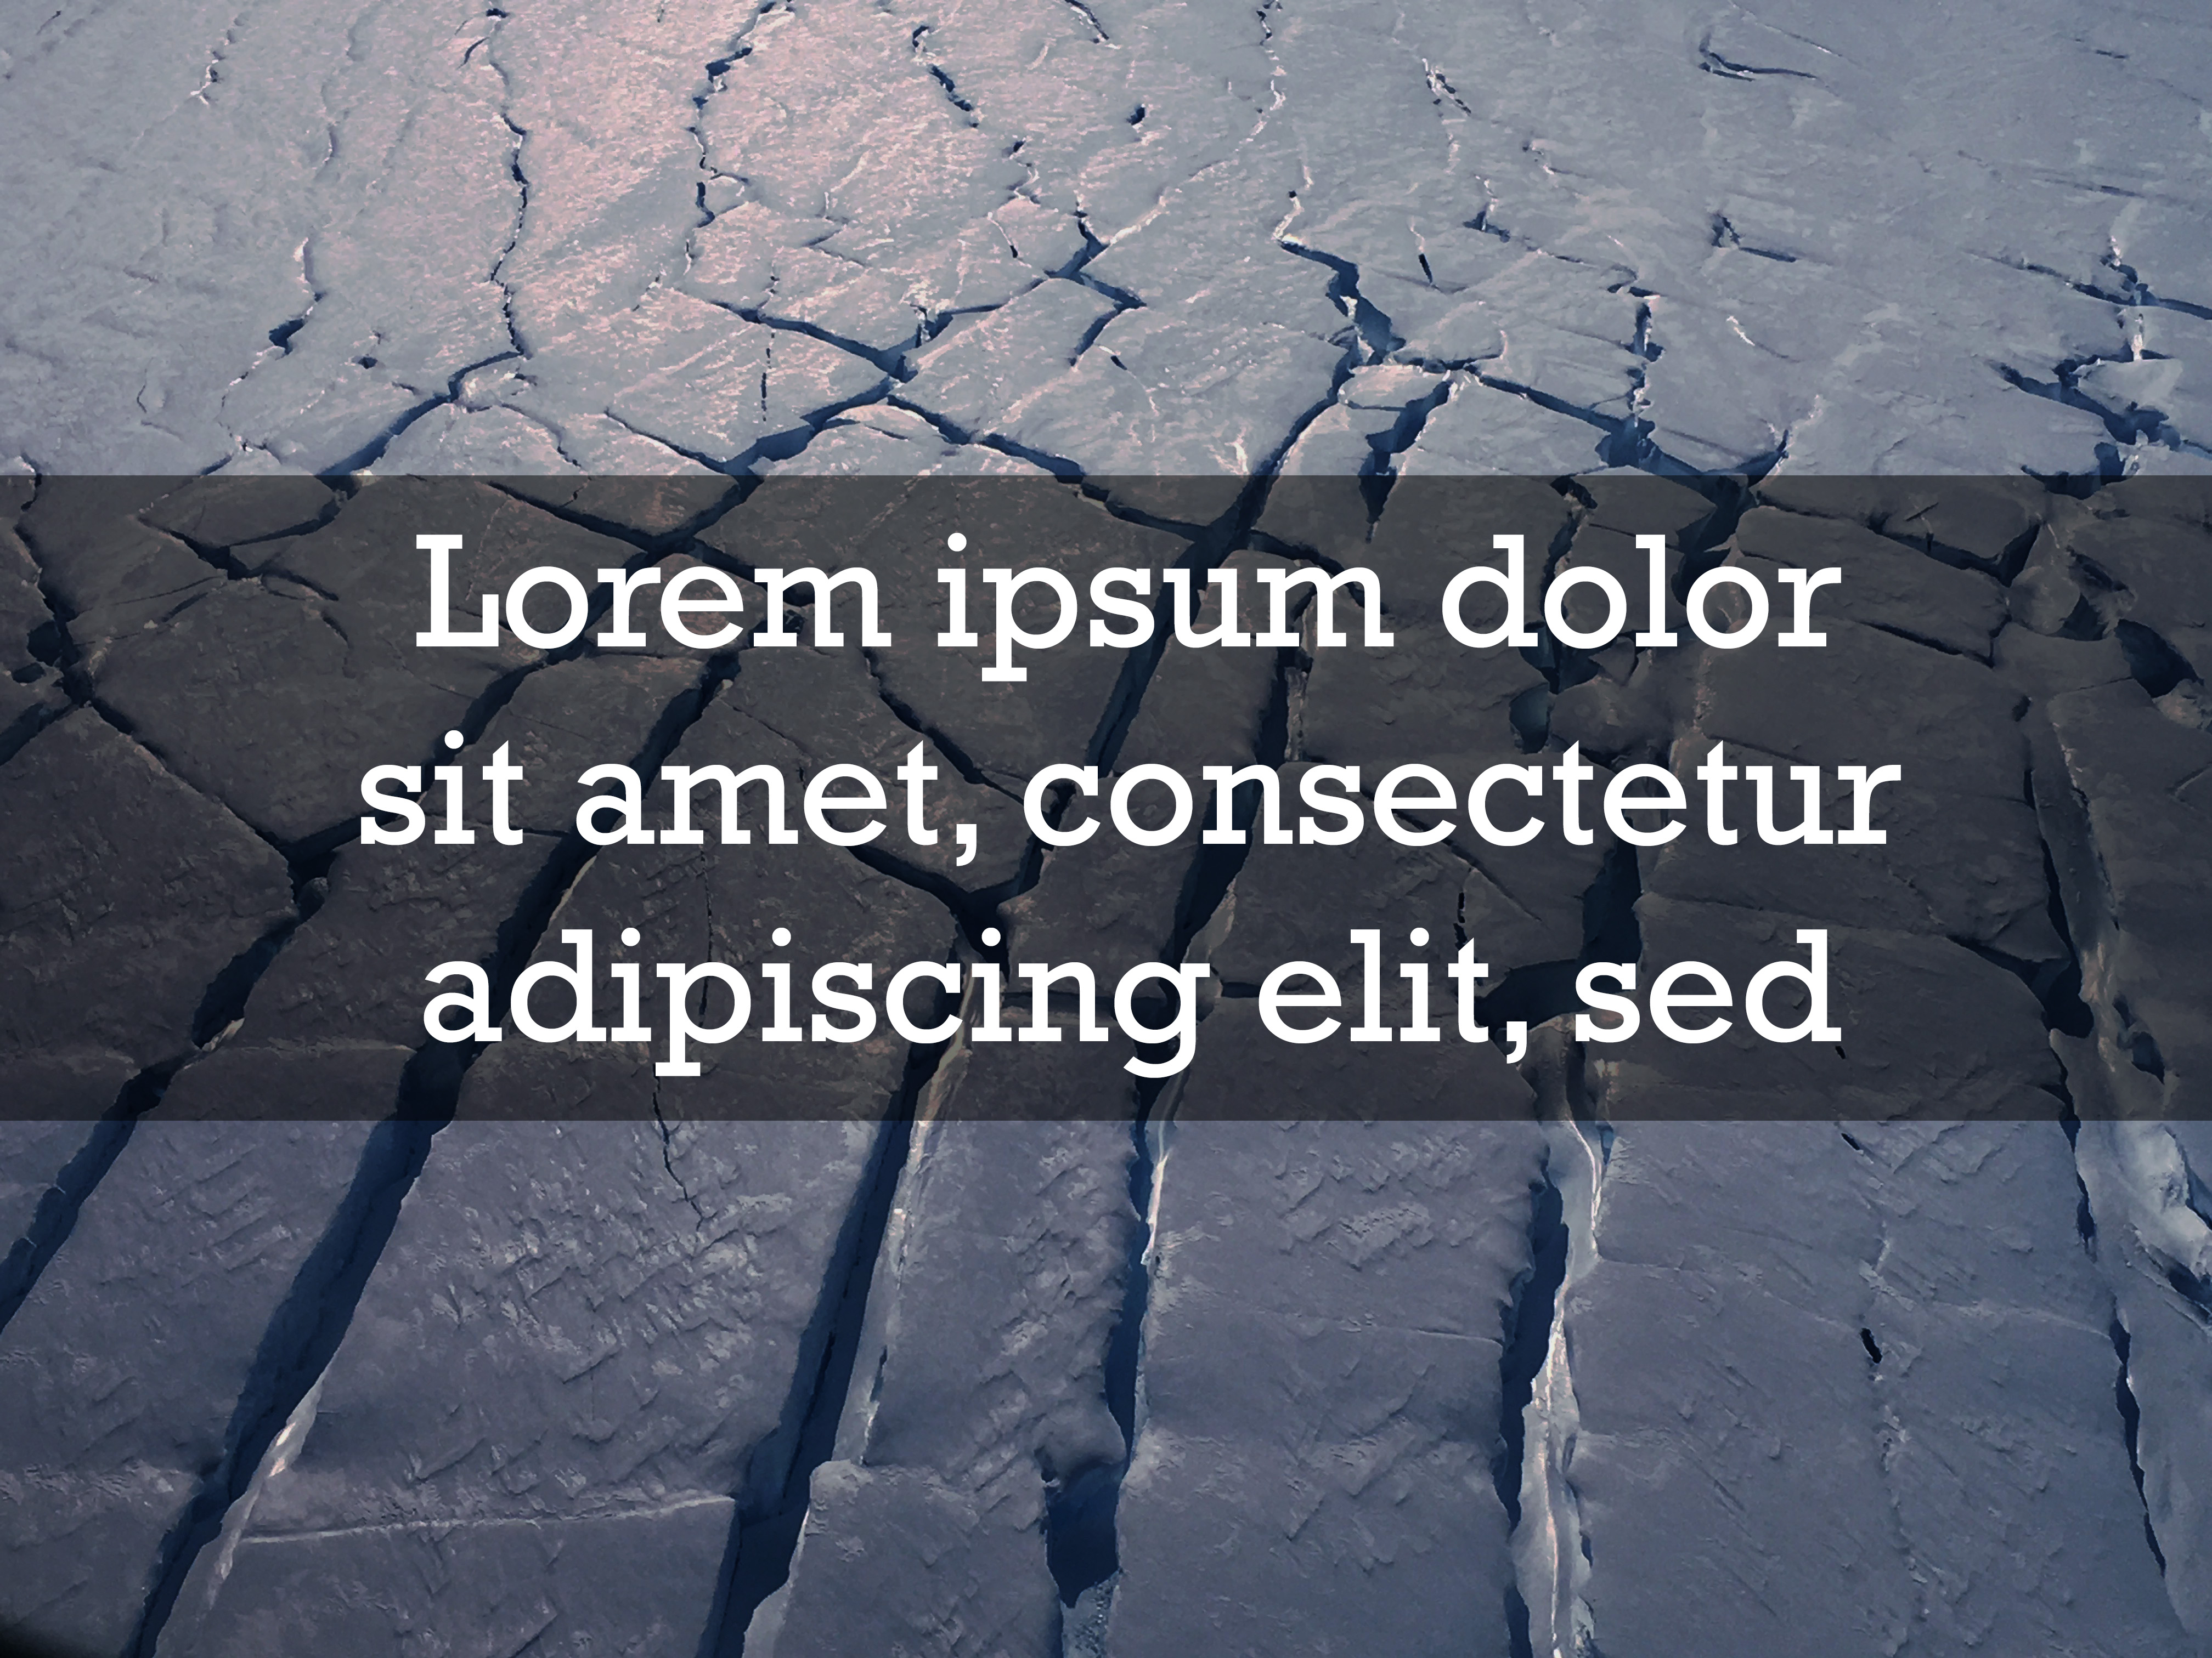

3:
Main screen background

Slide 4
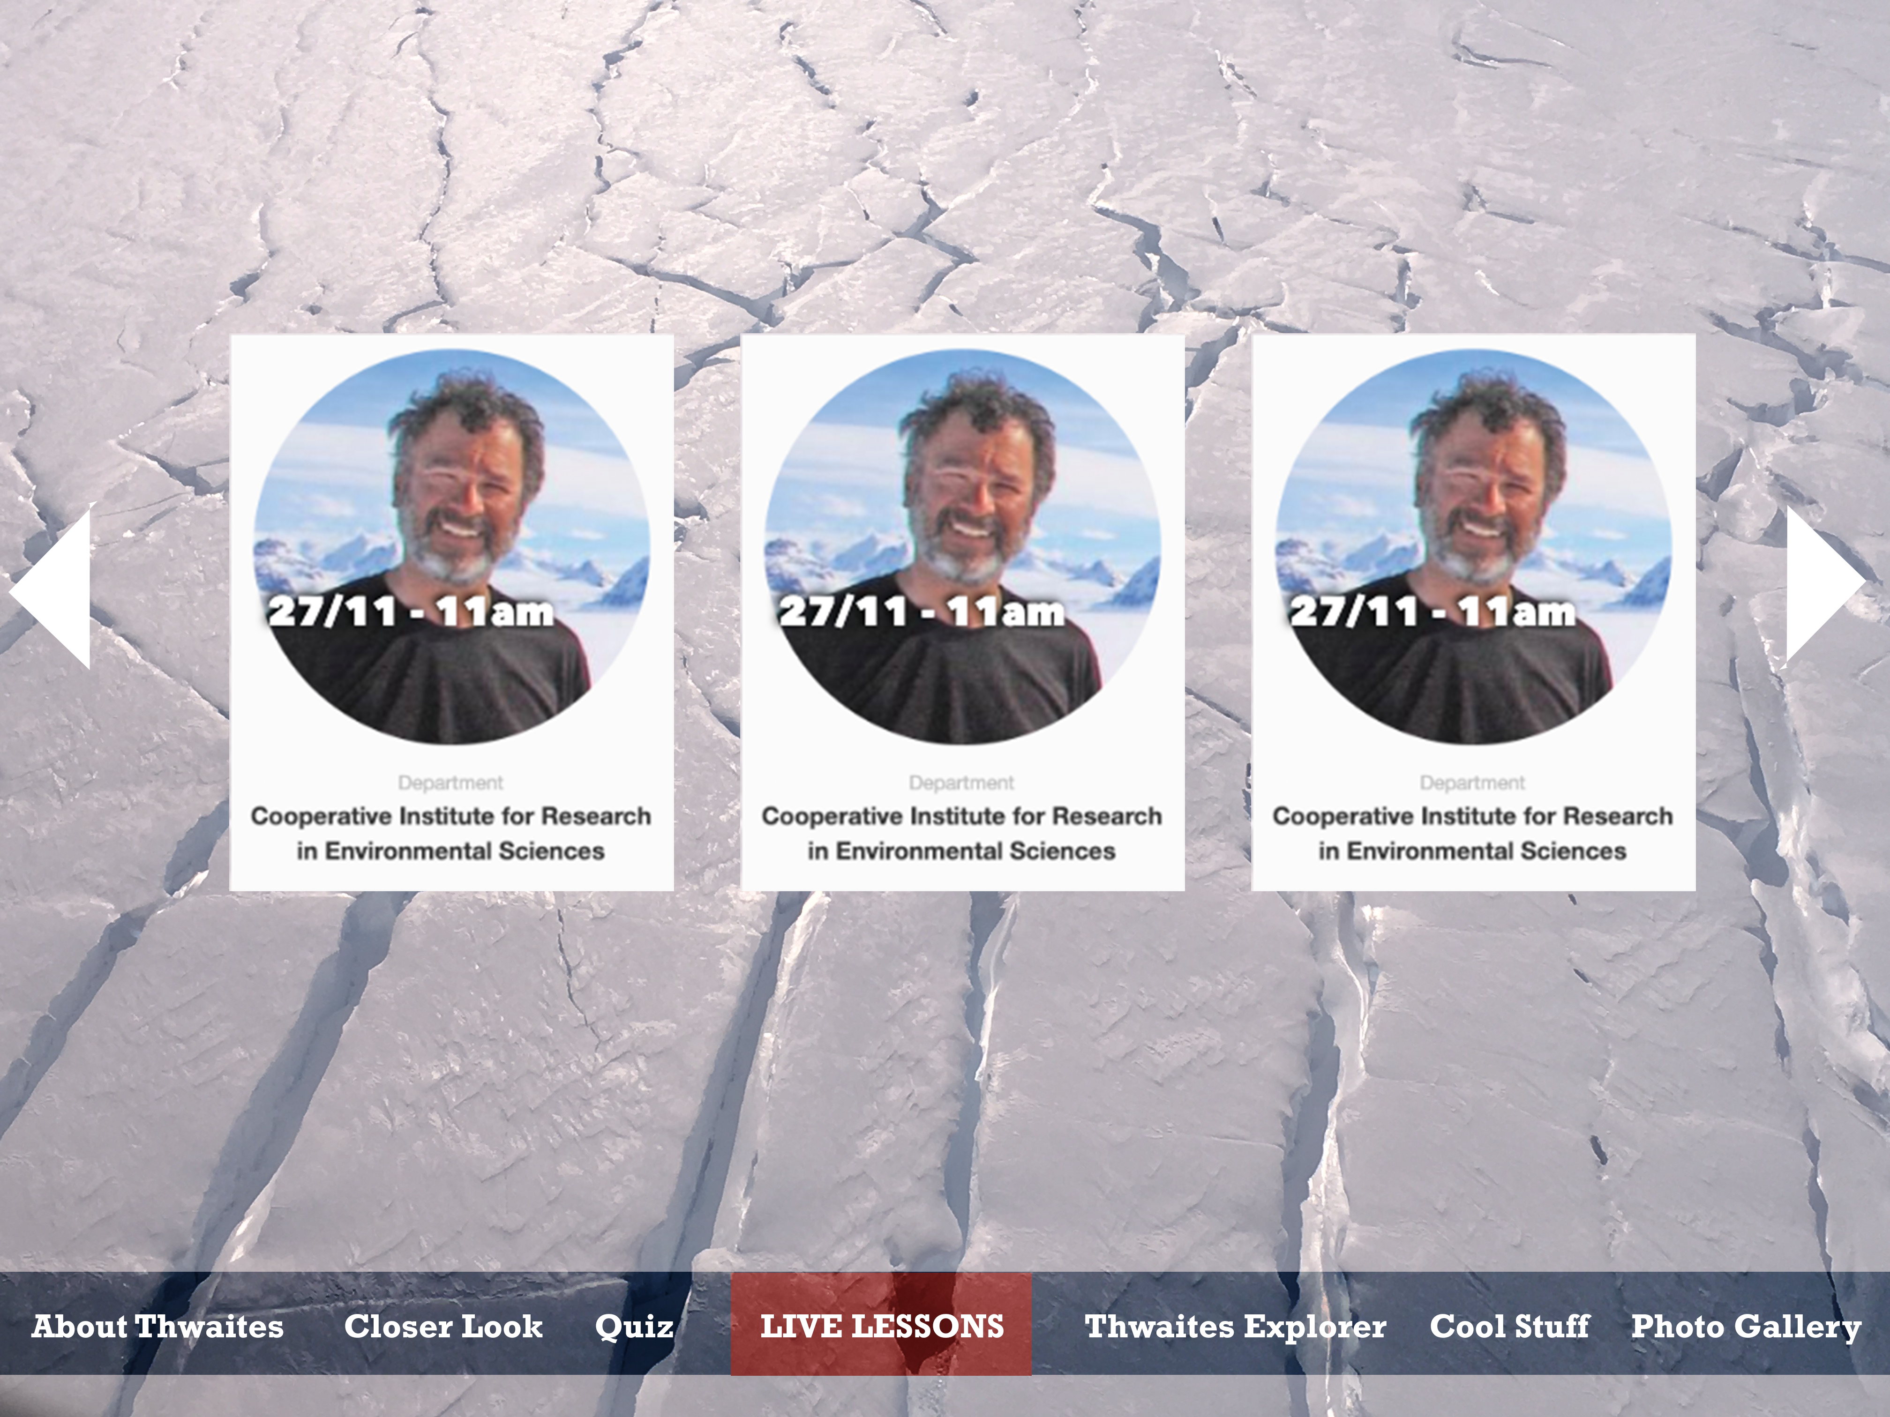
4:
Main page with menu

Slide 5
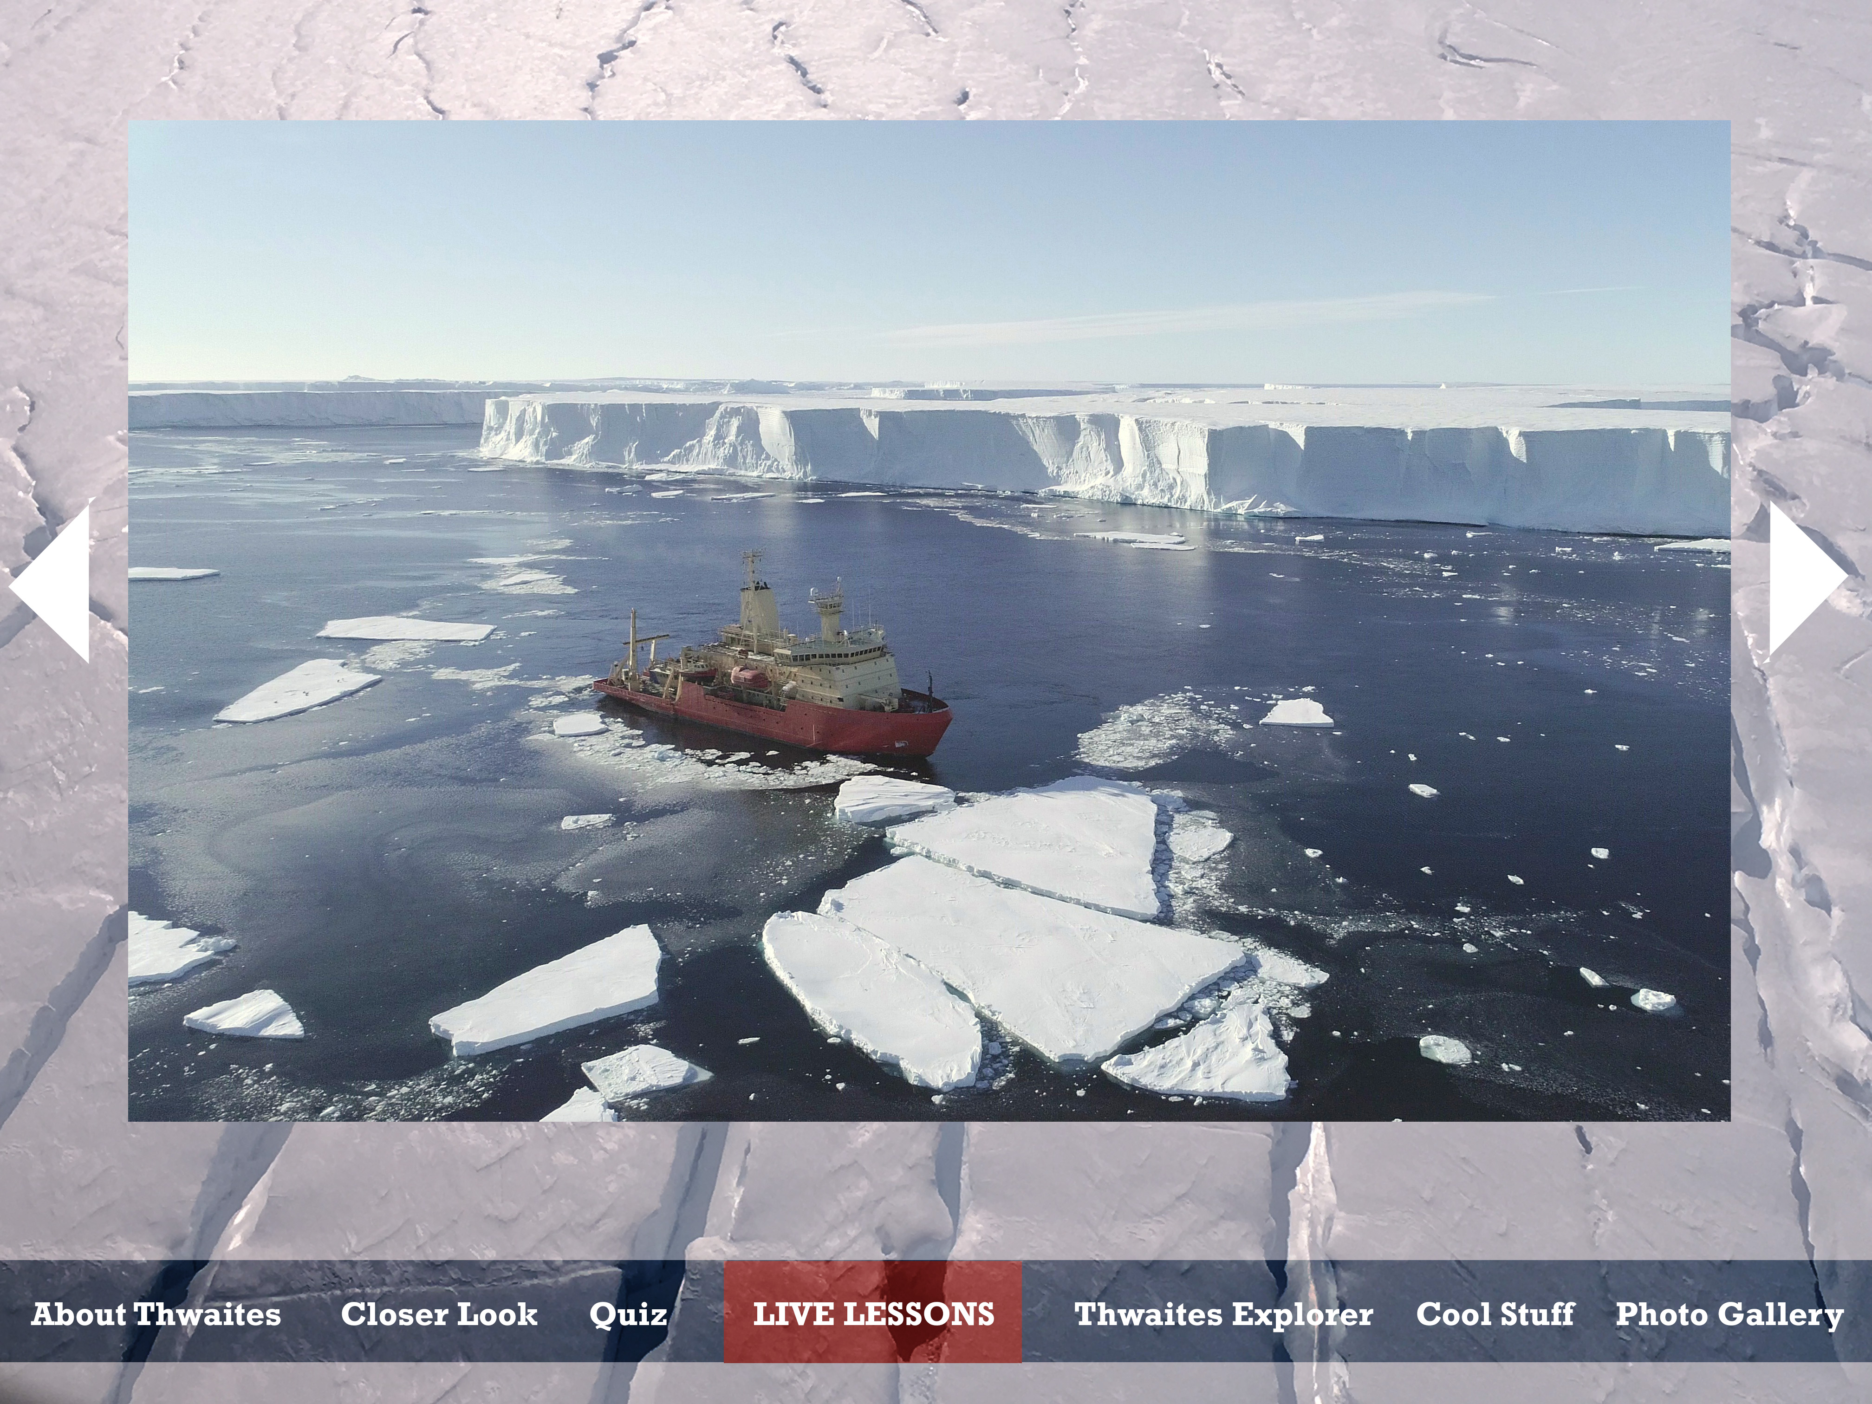
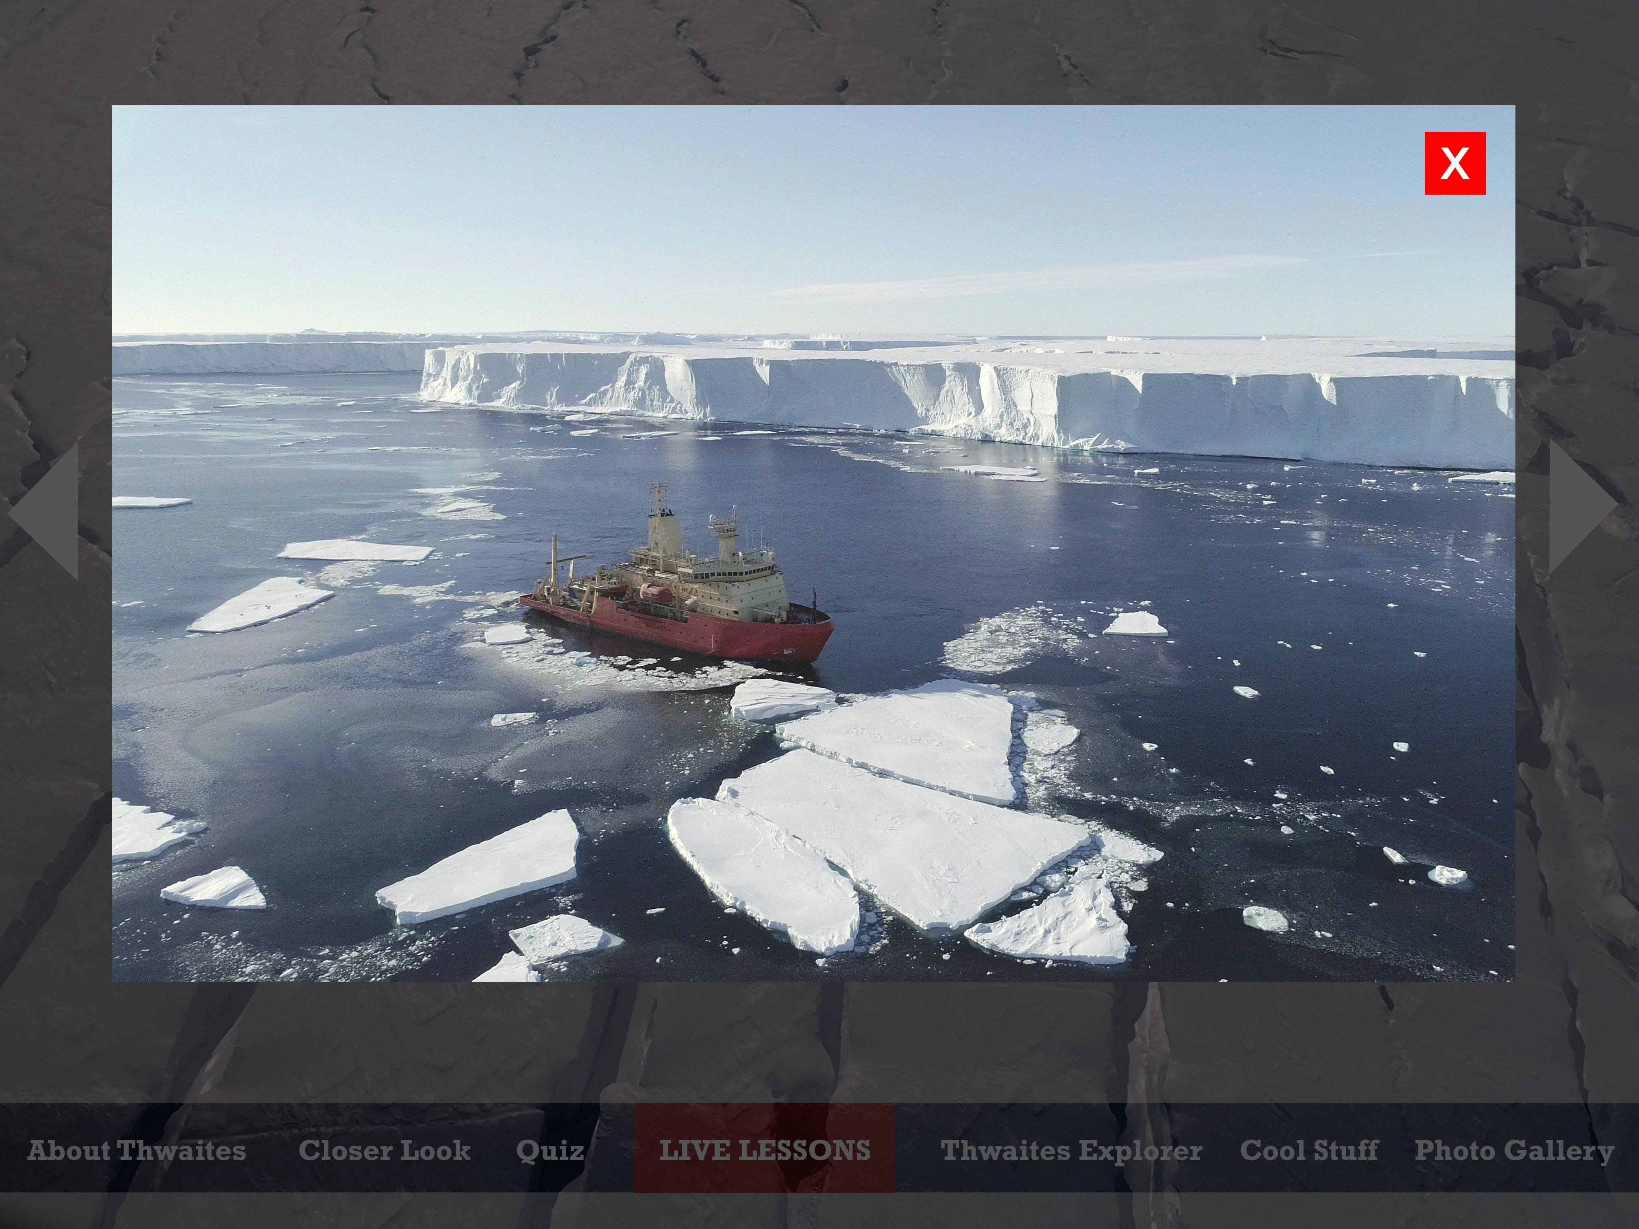
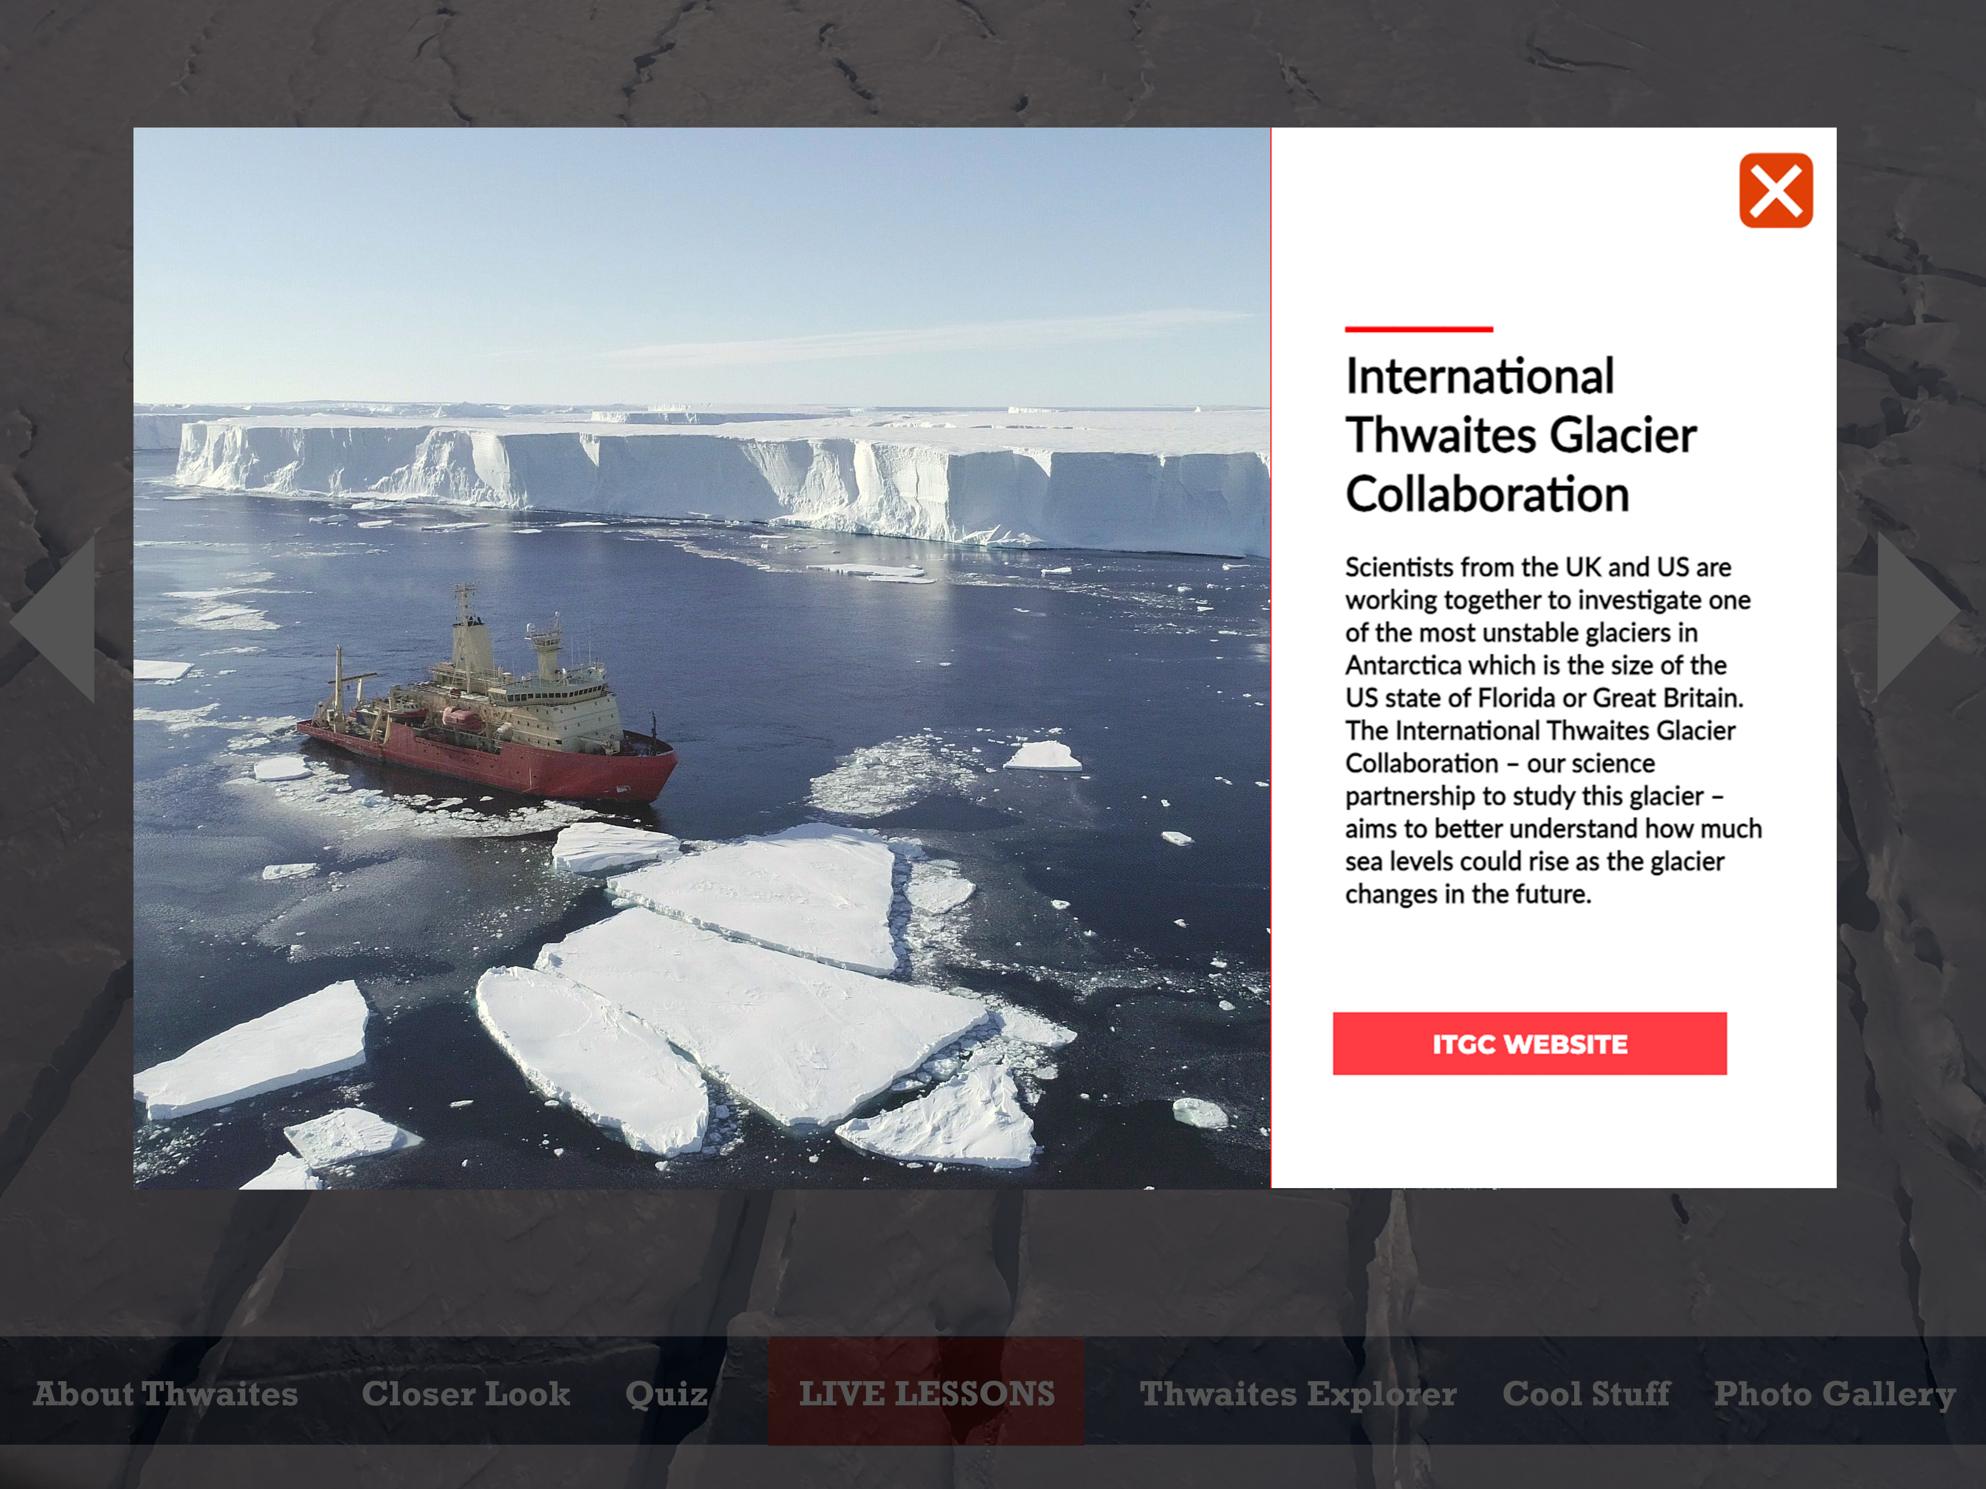
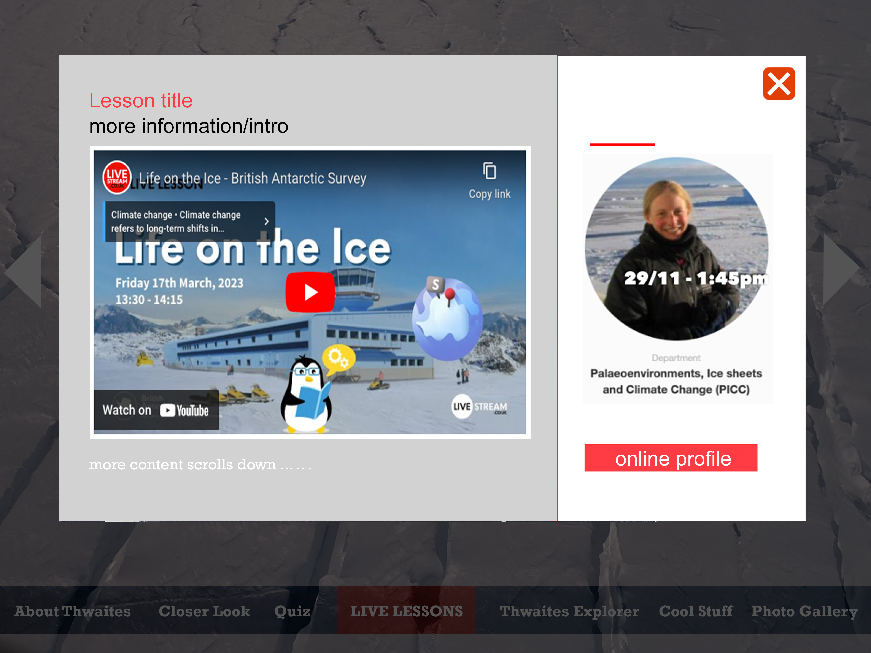
5:
Live Lesson page!

Slide 6
6:
About Thwaites page

Slide 7
7:
Image gallery
+ other content to use same area!

