Slide 1
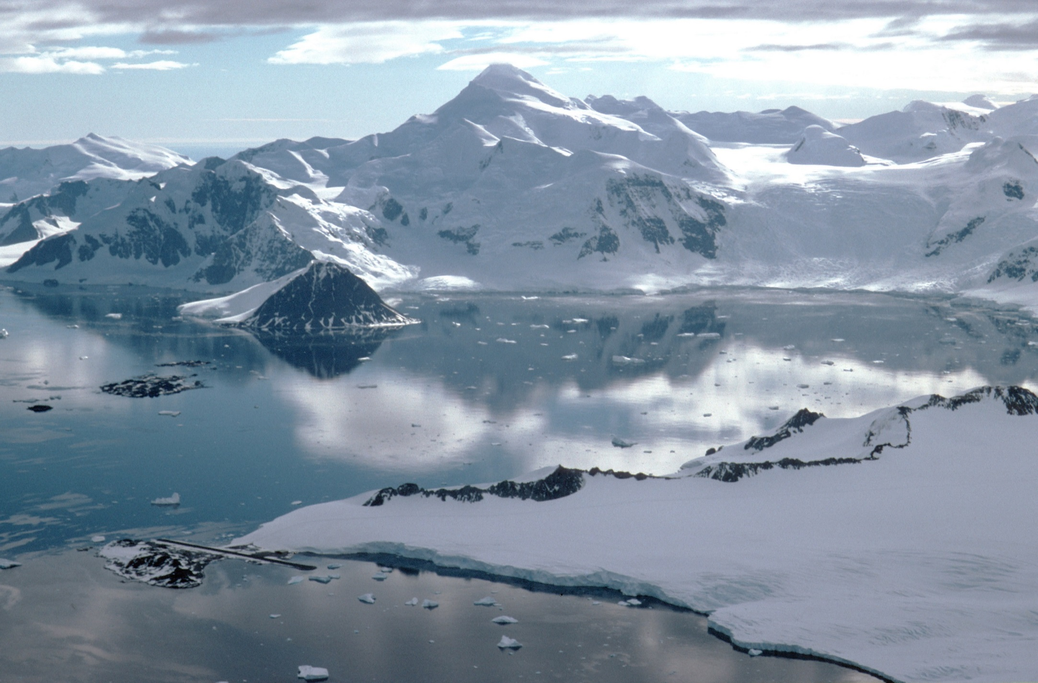
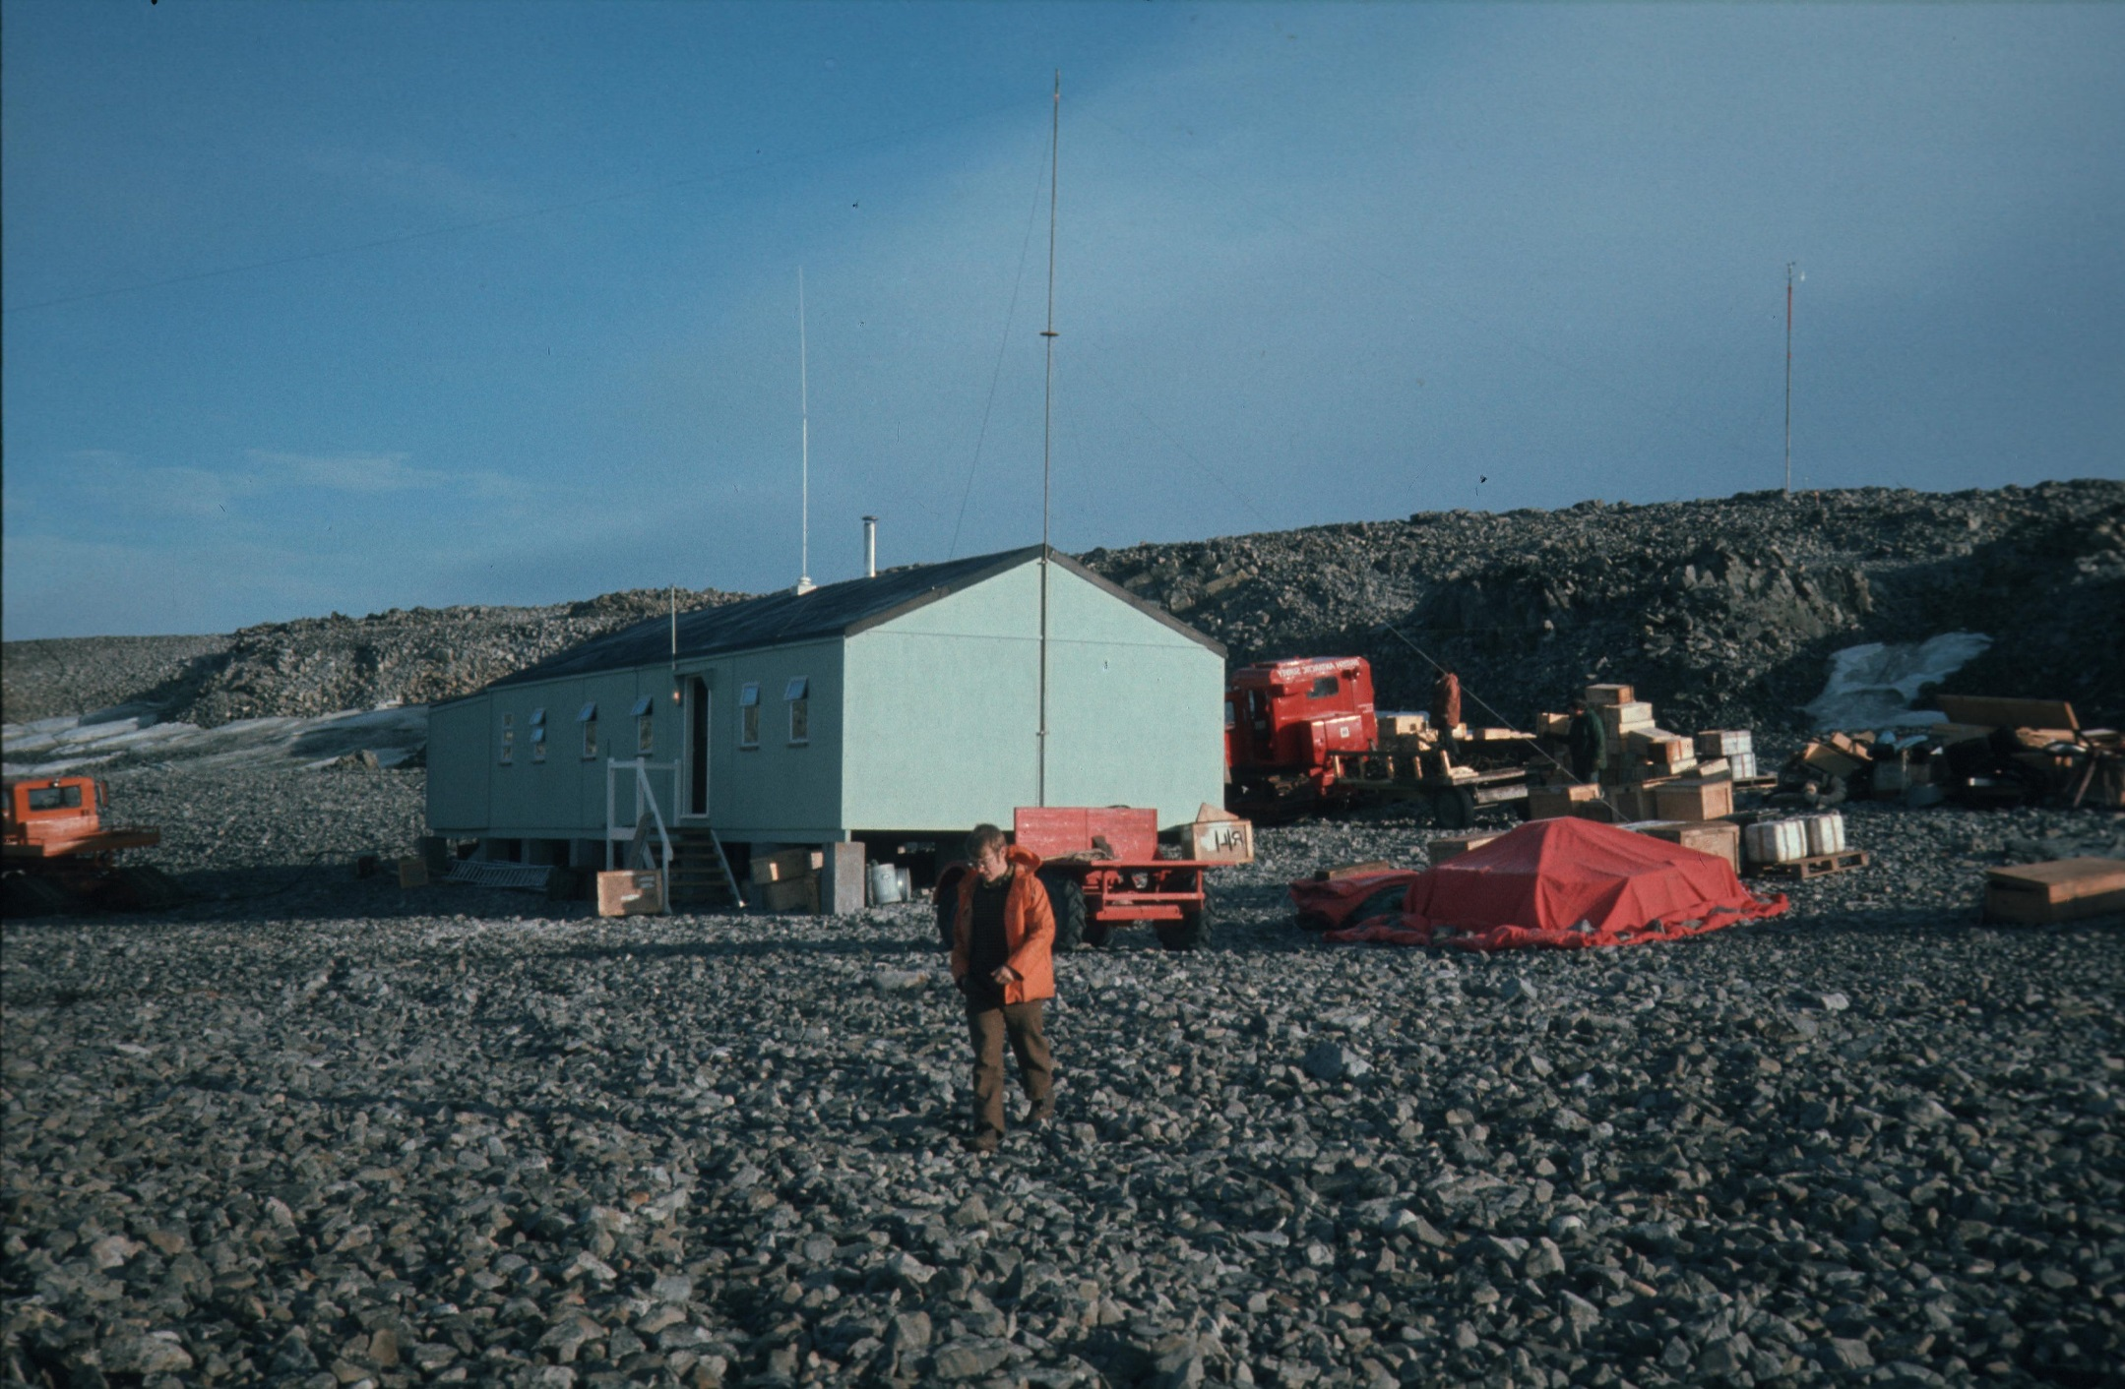
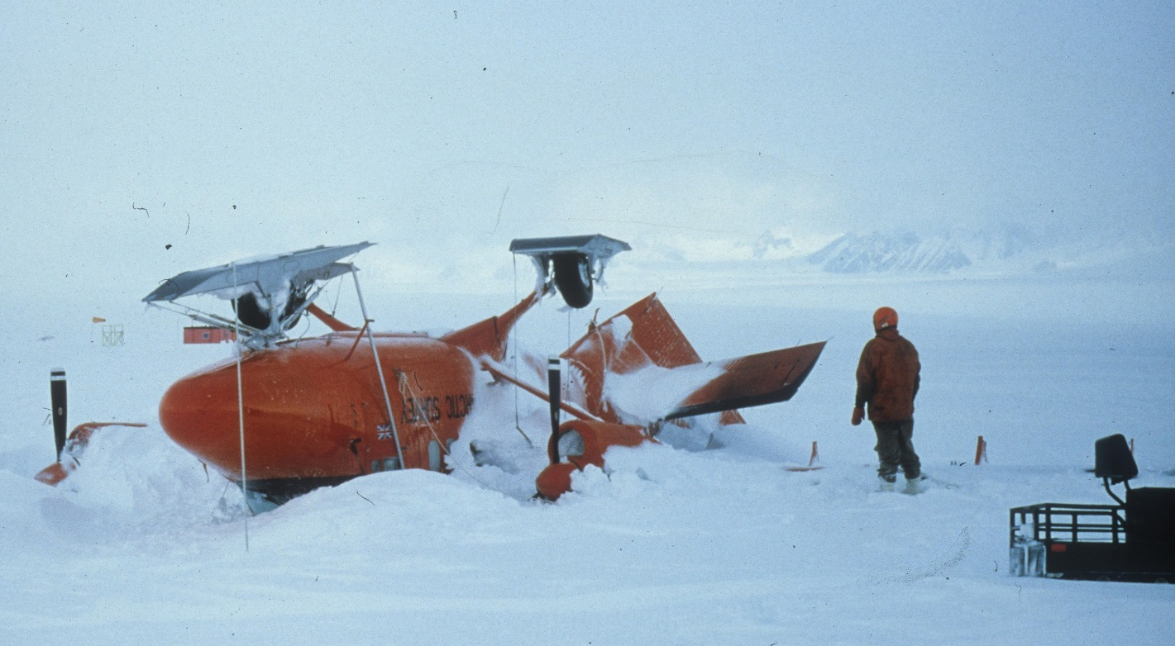
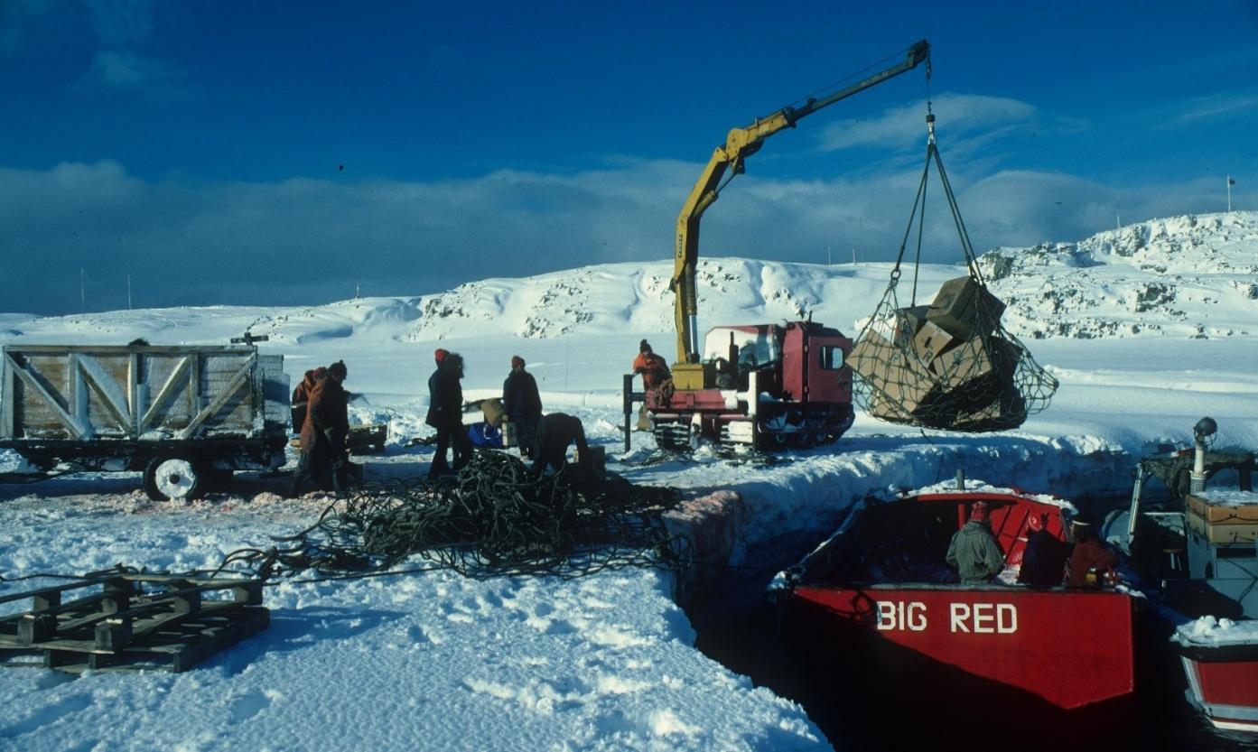
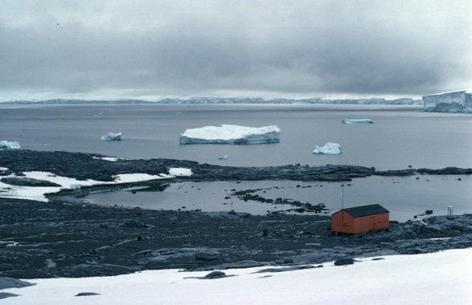
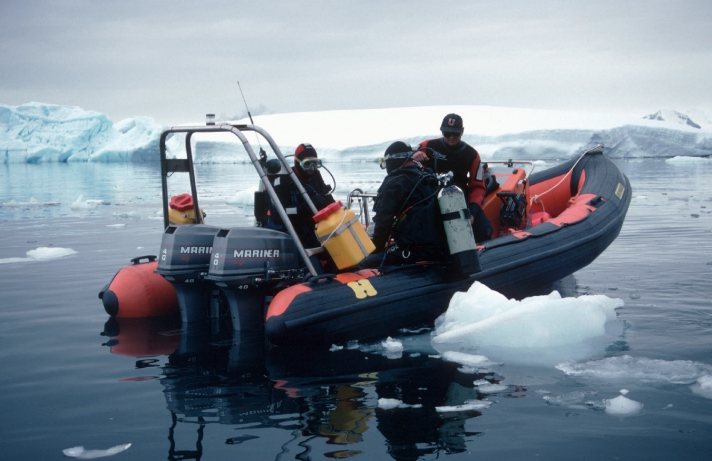
A History of Rothera Research Station
Joanna Rae
British Antarctic Survey Archives Service
Introduction
In October 1957 the feature now called Rothera Point was visited by a field party from Base Y, Horseshoe Island, led by surveyor John Rothera. It was named for him in 1960 by the Antarctic Place-Names Committee.
13 years later, with the deterioration of the skiway serving Base T, Adelaide Island, Rothera Point was selected as the site for a new research station planned as the centre for BAS’s earth science field work. It was a key element in a new, modernised Antarctic infrastructure, dominated by air and mechanised transport to input summer-only field parties. The station was re-named Rothera in 1977. The site has developed over the last forty years to meet increasing demand for summer accommodation (33 in 1977/78, 100 now), multi-disciplinary science and international collaborative field work over an ever-expanding geographical area to address global scientific questions.
Buildings
Station established 25 Oct 1975. 1st hut built Feb 1976 for wintering party of 4.
1976/77 Phase 2 - accommodation block, power house, tractor shed, Bingham House brought from Base T
1978/79 Phase 3 – Fuchs House travel store, offices, coldroom
1985/86 Phase 4 – Bransfield House, extension to phase 2
1991/92 Miracle Span store
1994/95 Boatshed
1996/97 Giants House transit accommodation, Bonner Laboratory operational (re-built 2002/03)
1999/00 Admirals House and air ops control tower
2007/08 New Bransfield House
2012/13 Dirck Gerritsz Laboratory
Phase 1 hut, 1976/77 (ref AD6/19/3/C/R5)
Transport
1975 Snow skiway on Wormald Ice Piedmont with control caboose, transit facility at Damoy Point, Wiencke Island, essential for early start to field work
1979/80 RRS Bransfield ran aground N. of Jenny Island
1981/82 Chilean aircraft used the airstrip extensively for 1st time
1991/92 Gravel runway, hangar, associated facilities & wharf operational
Feb 1994 last huskies removed from Antarctica
Increasing aircraft capacity – 2 Twin Otters, 3 from 1983/84, 4 from1987/88, Dash 7 in service from1994/95, transforming travel to Rothera
Improvements in flight control – automatic picture transmission (1979/80), air ops tower (1999/00), operational met forecasting (1993/94)
Deep-field capacity extended from Fossil Bluff, to Sky-Hi (1987/88) and Sky-Blu (1996/97)
Without a hangar there was always a risk of damage from high winds on the skiway. VP-FAZ, Nov 1981 (ref 1995/114)
Cargo handling before Biscoe Wharf built (ref 1995/114)
Damoy hut, transit air facility (ref AD6/16/3/C/damoy2)
Science
Centre for earth sciences field work, including cryosphere studies
Geology, terrestrial geophysics, airborne geophysics (aeromagnetics) and glaciology (echo sounding, ice cores), floating ice/ocean interactions – Peninsula, extending rapidly to Shackleton Range, Ronne Ice Shelf, Pensacola Mountains & Marie Byrd Land, making use of deep-field air facilities from 1988
Topographic survey and mapping, including BAS/US remote sensing projects, aerial photography from 1982/83, GPS from 1990/91
Biological benchmark survey 1975/76, followed by ongoing monitoring, including skua colony from 1988, and full biological programme when Signy Station became summer-only 1996/97
1982/83 VLF (Very Low Frequency) observations
1983/84 Ambitious BAS/US multi-disciplinary earth sciences programme, including flights to S. Pole
1992/93 In-depth terrestrial biology studies on Alexander Island
1993/94 Marine survey of Ryder Bay
1996/97 Diving programme started, collaborative BAS/Dutch biological studies
1997/98 Rothera Time Series (RaTS) started, Mesopheric rocket campaign
Glaciologist’s oceanography sledge, 1976/77
(ref AD6/2R/1976/S)
Divers, 1997/98 (ref 10004030)

Slide 2
Rothera Time-Line
1957/58 Surveyed by John Rothera & Len Maloney from Base Y, Horseshoe Island
1960 Rothera Point named after John Rothera by Antarctic Place-Names Committee
1973/74 RRS Bransfield checked site and anchorage, transit skiway opened at Damoy Point, Wiencke Island
1975/76 Base R “Rothera Point” established 25 Oct 1975 - Phase 1 hut, skiway on Wormald Ice Piedmont
Damoy Hut erected, biology benchmark survey
4 wintered
1976/77 Phase 2 – accommodation block, power house, tractor shed. Bingham House brought from Base T by tractor train
42 huskies (4 teams) transferred when Base T closed
Geology, airborne glaciology & geophysics, floating ice/ocean interactions, BAS/US Doppler Satellite programme for mapping
Base R re-named “Rothera Station”
1979 Phase 3 – offices, travel store, cold-room (Fuchs House), Centre for Earth Science fieldwork
Travel extended from Peninsula & Shackleton Mts to Pensacola Mountains, Rutford Ice Stream, Berkner Island
1980/81 Radio echo sounding Bryan Coast & Pine Island Glacier
1981 John Anderson & Robert Atkinson killed in crevasse accident 16 May RIP
1981/82 Both Twin Otters wrecked in freak storm, temporary Chilean use of skiway
1982/83 Aerial photography, VLF observations
1983/84 Satellite communications replaced teleprinter, 3 Twin Otters, ambitious BAS/US earth sciences project
1985/86 Phase 4 started - Bransfield House
26 wintered
1987/88 4 Twin Otters, Sky-Hi snow skiway opened for deep field operations, 1st woman scientist working from field camp
1991/92 Gravel runway operational, with hangar, fuel tanks, wharf, Miracle Span store
1992/93 In-depth terrestrial biology studies started on Alexander Island
1993/94 Operational met forecasting started, last dogs removed from Antarctica
1994/95 Dash-7 1st flight to Rothera, boatshed completed, Kenn Borek aircraft crashed RIP
1996/97 Giants House built, Bonner Laboratory & Sky-Blu ice runway operational
Biological studies expanded with winter closure of Signy – diving, BAS-Dutch project
1997 1st women wintered
1997/98 Rothera Times Series (RaTS) started, Mesospheric rocket campaign
1999/00 Admirals House started, air ops control tower added
2002/03 Bonner Lab re-built after fire
2003 Kirsty Brown killed in leopard seal attack RIP
2007/08 New Bransfield House built
2012/13 Dirck Gerritsz Laboratory opened – BAS/Dutch collaboration
2013/14 1st season of iSTAR programme using Rothera as a gateway, via Sky-Blu, for tractor train
2014/15 Ops GIS in use
Joanna Rae
British Antarctic Survey Archives Service

