Slide 1
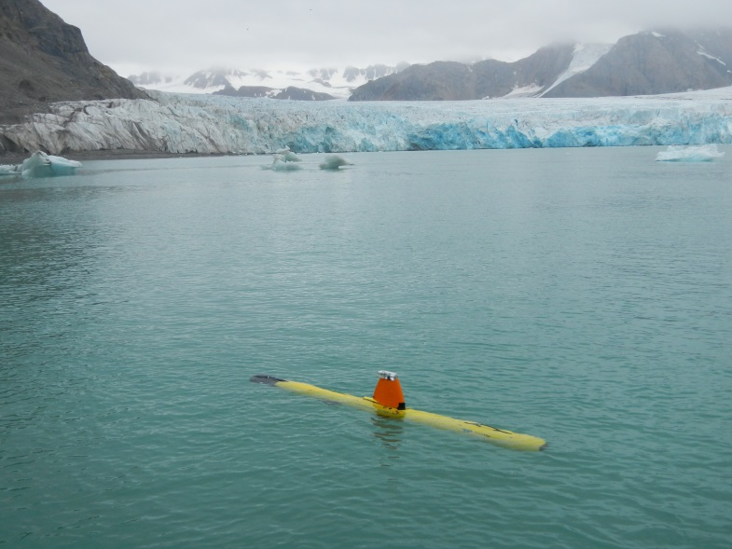
Photo of Gavia AUV or “marine robot” in a Svalbard Fjord in 2016
Credit: John Howe, Scottish Association of Marine Sciences

