Slide 1
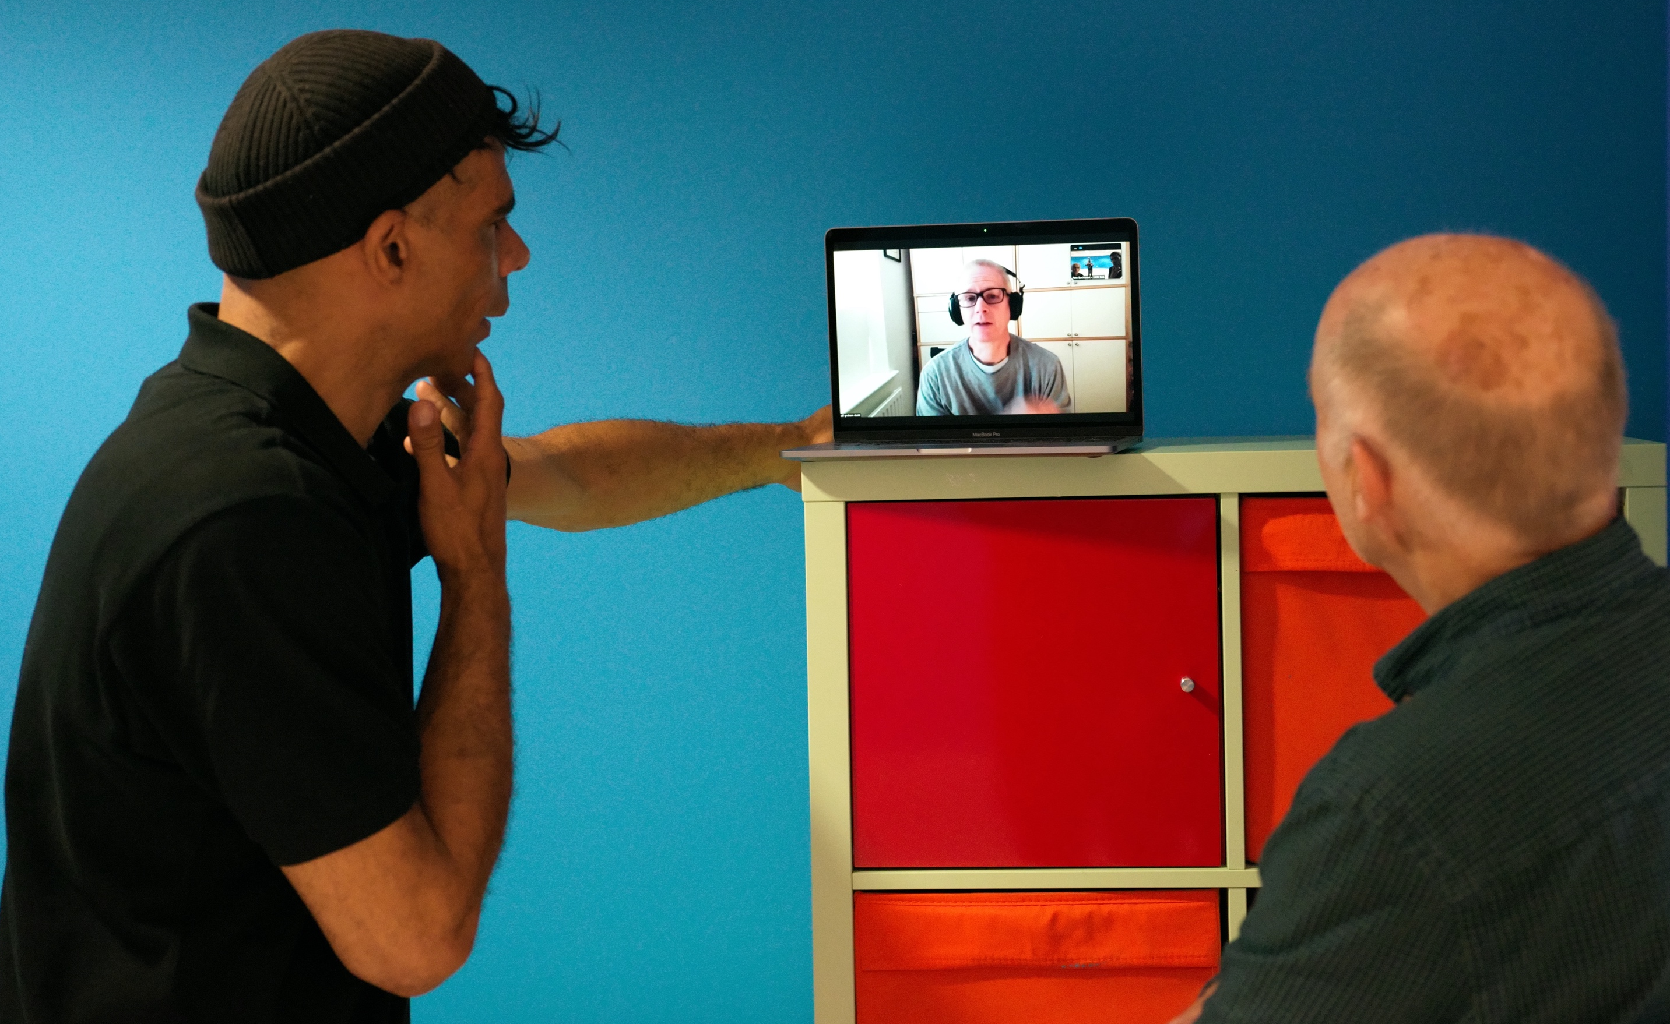
COP26 Polar Zero
GSC site visit images
14 July 2021
Pete Bucktrout
Senior Creative Services Manager
British Antarctic Survey

Slide 2
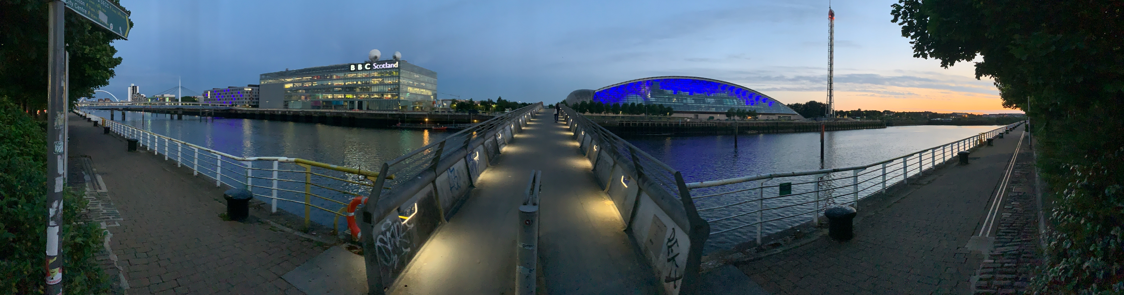
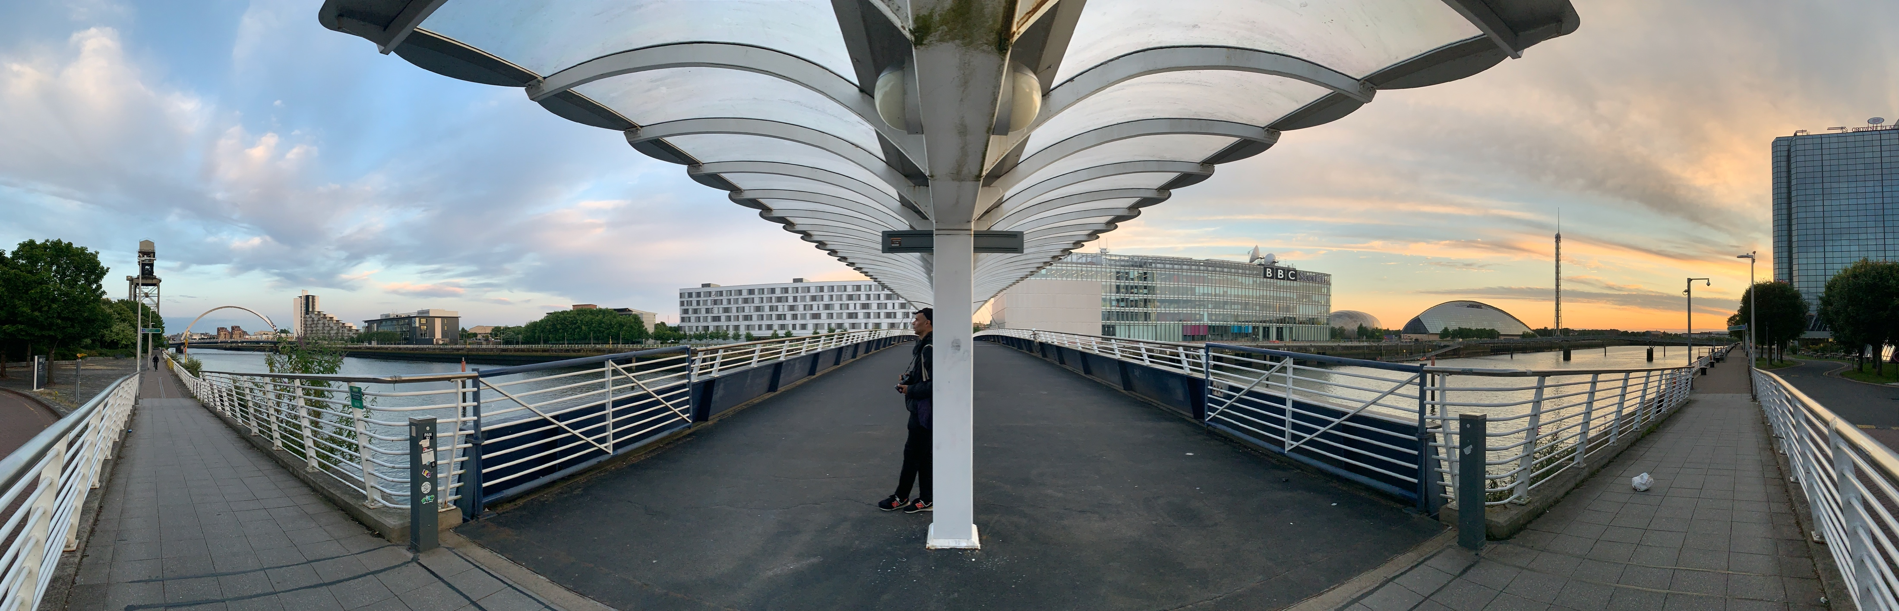
GSC
The two foot bridges across the Clyde – looking south across to the Science Centre
GSC

Slide 3
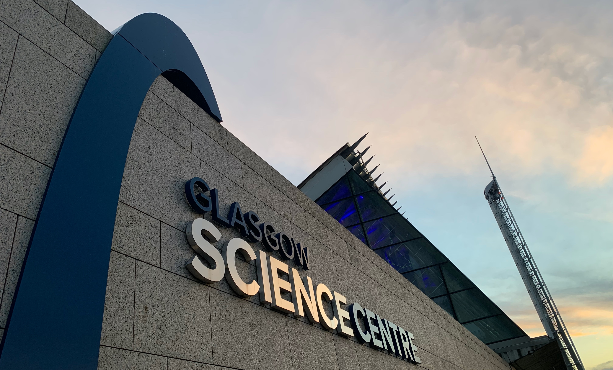

Slide 4
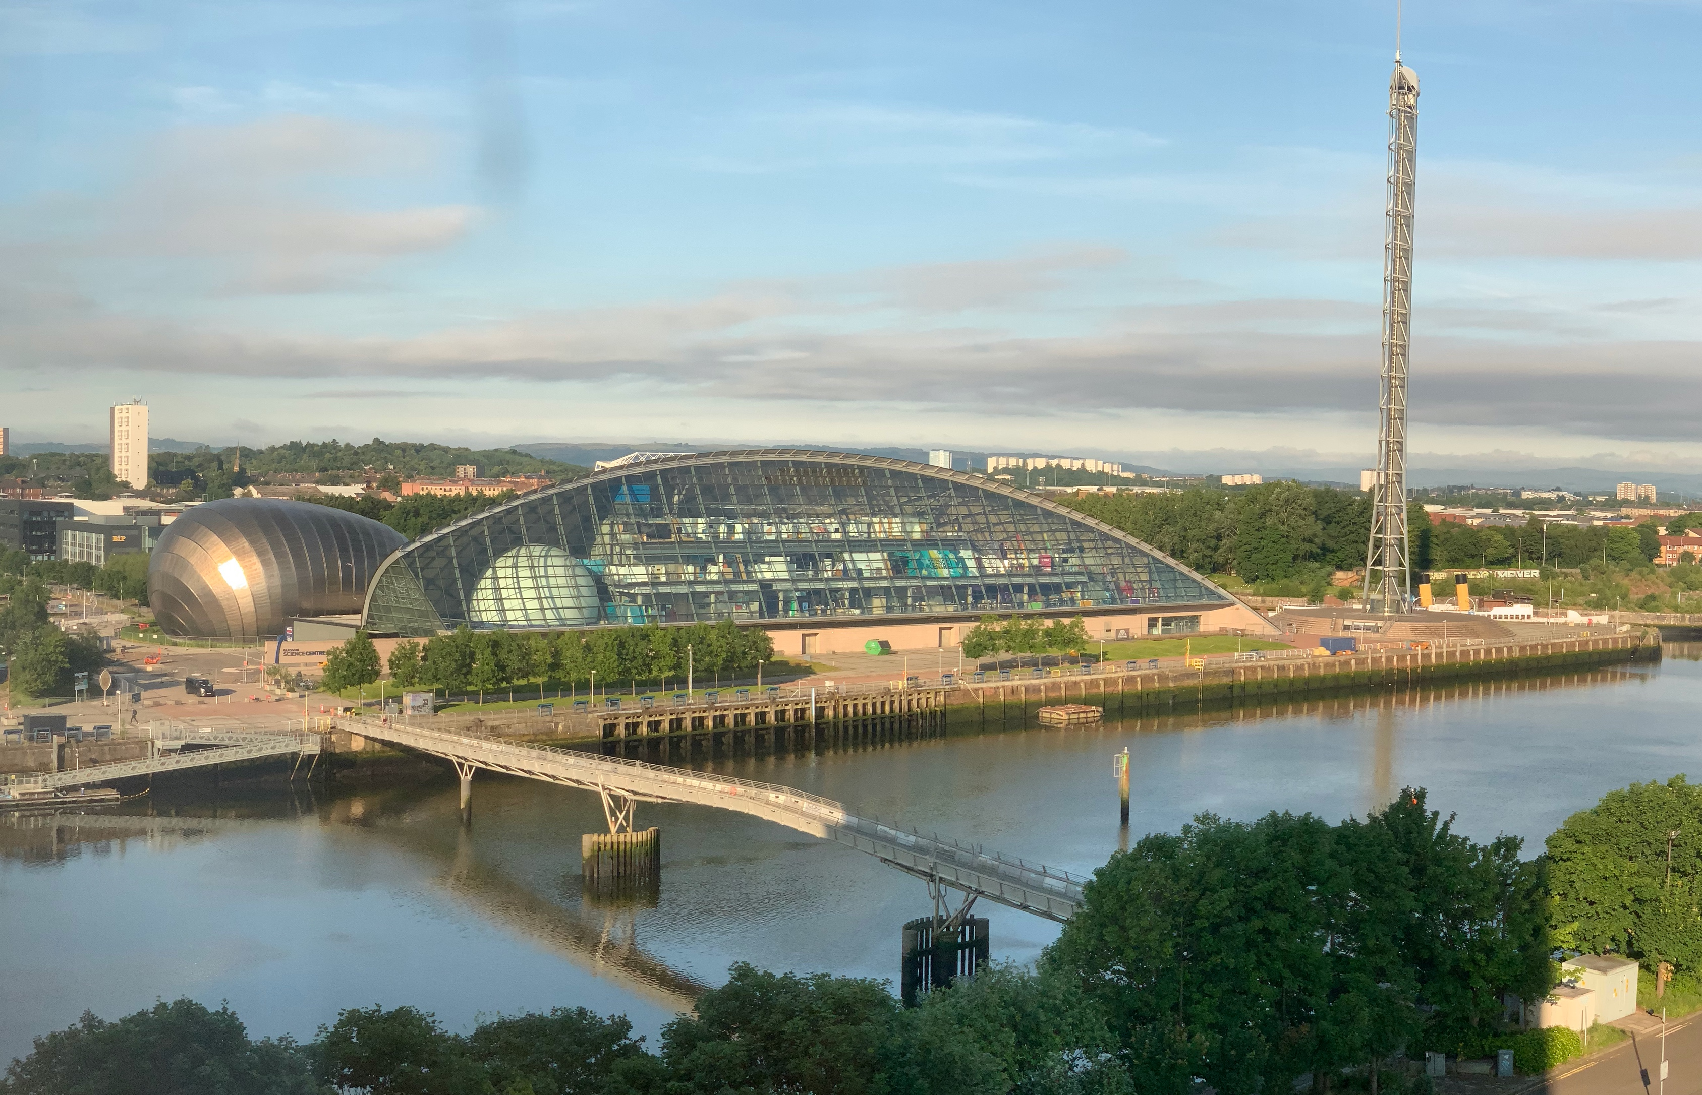

Slide 5
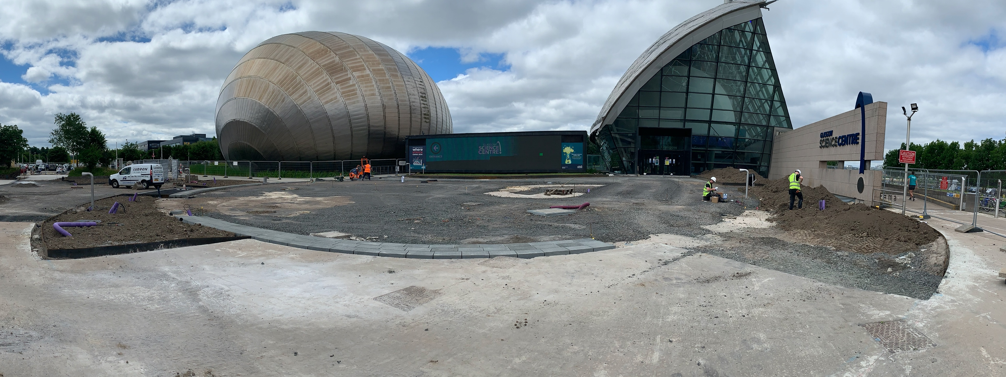
Large Information screen
Pedestrian walkway along the River
Car
Park
IMAX Cinema
Temp Entrance
Main Entrance
Deliveries
Looking Towards the front of the GSC – car park to the left, river to the right
The whole area outside the Science Centre is being redeveloped with new pedestrian and cycle access
Currently access is via a temporary access door (past the shop

Slide 6
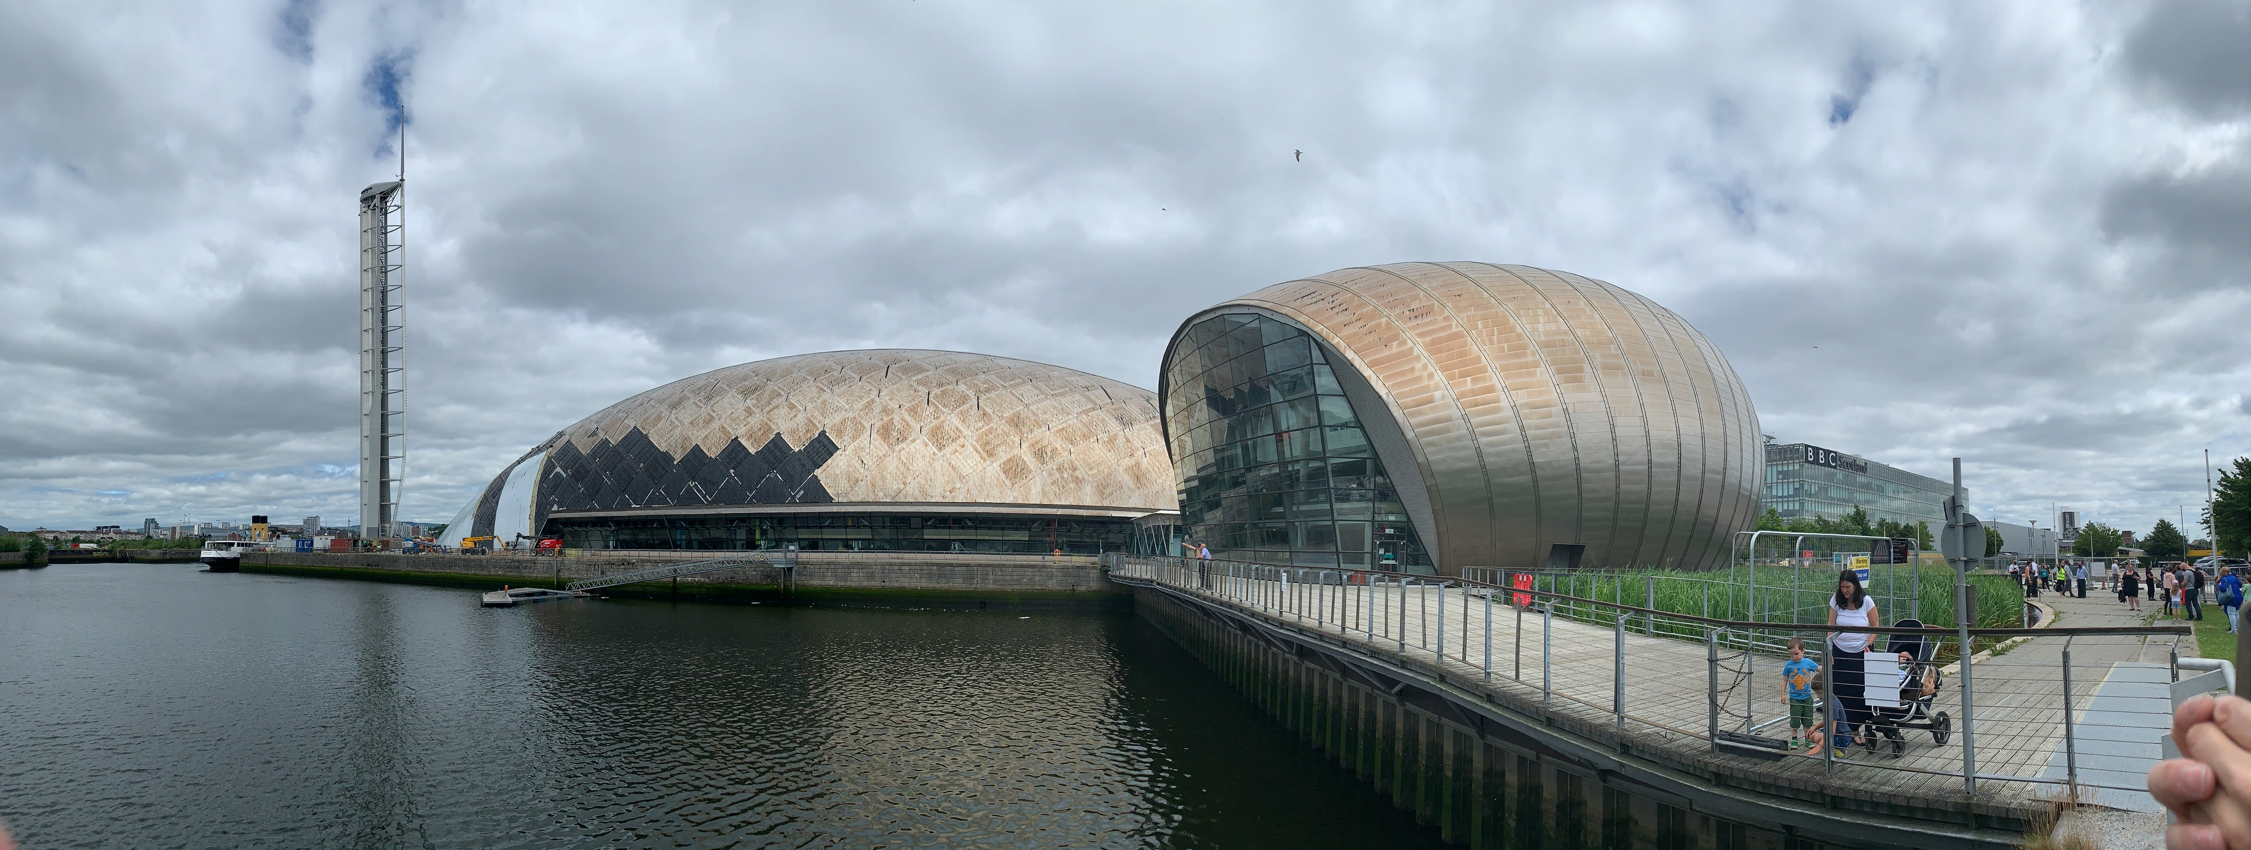
Glasgow Science Centre
Main entrance behind the buildings
IMAX Cinema
Car
Park
Observation tower
The location of the egg
The view of the Science Centre from the south side, the river is beyond the buildings.
This is s being redeveloped so currently walkways around are out of access.

Slide 7
COP26 Polar Zero
The Egg
The Egg is the curved elliptical room or exhibition space, within the Glasgow Science Centre, allocated for our Polar Zero ‘1765’ artwork and ‘Ice Core’ installation.

Slide 8
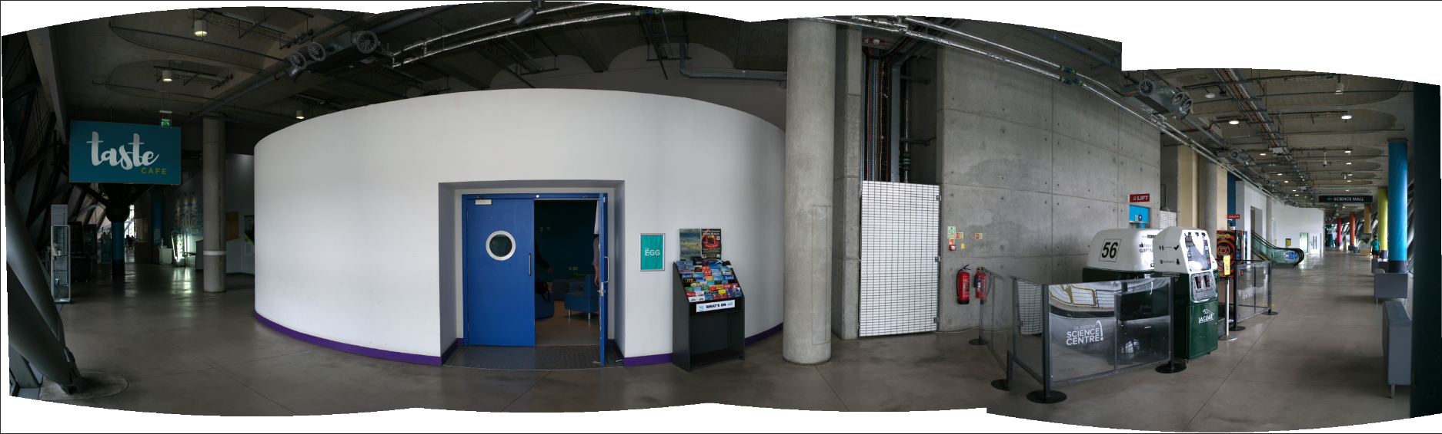
External egg wall for information
Double door access to the egg
Possible concrete wall for exhibition or artworks
Primary walkway from the main entrance
Café or restaurant
Drawings/measurements of the egg to be provided by GSC

Slide 9
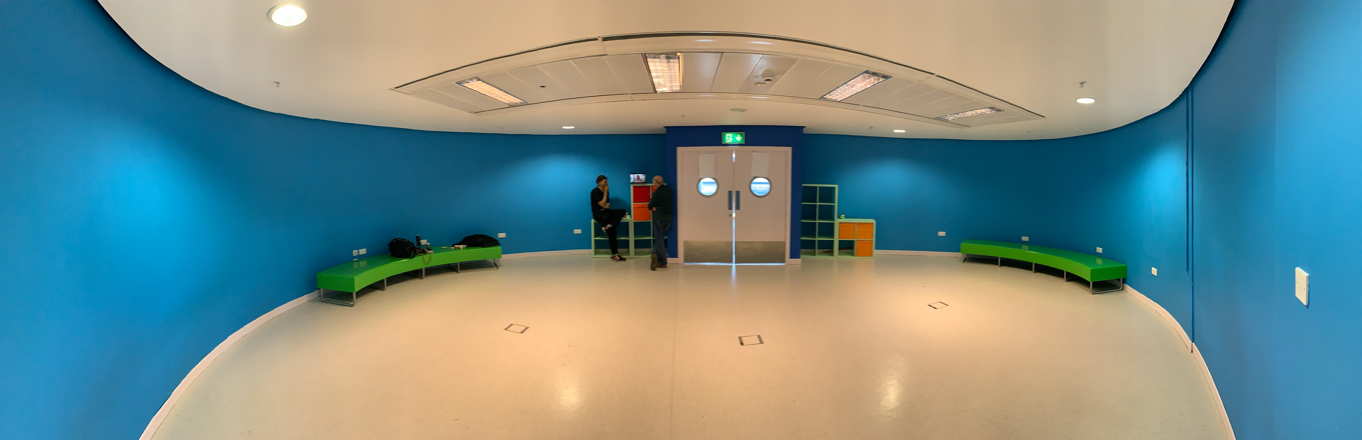
The egg - An elliptical space is a self standing room within the building which can be ‘blacked out’
360deg image below
Main access door – may need curtain or soft wall inside
Above the ceiling is a void with services above which is the concrete slab of the floor above (see next slide)
Walls can be painted or covered - If we put back to ‘as is’
Curved furniture available if needed. Could be painted’
Panel in roof provides air vents and lighting
3 power sockets in the floor (equally spaced)
Numerous power points around the floor

Slide 10
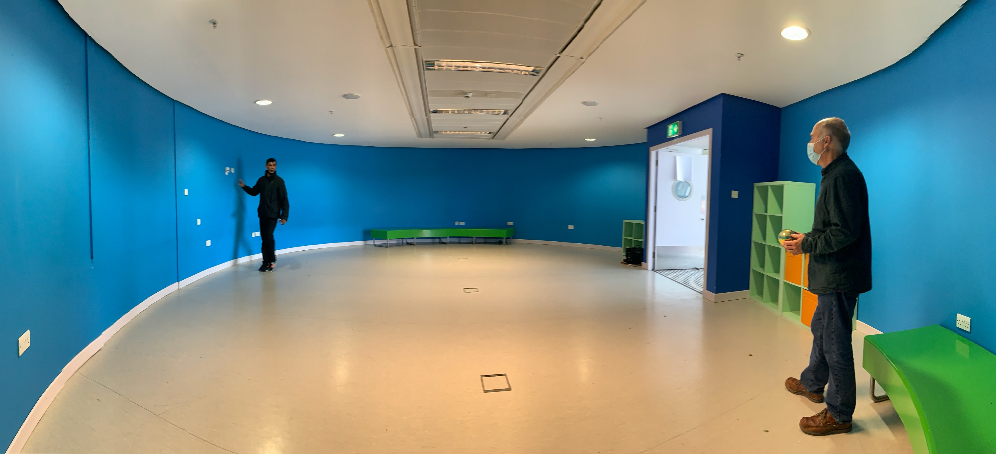
Image from the pointed end of the egg with the access door on the right
Lots of questions about the acoustics which are affected greatly by the removal of the soft furniture and would change again with curtaining around the walls … there were interesting sound ‘hot spots’ caused by the shape of the space … can these be used/controlled (if needed)

Slide 11
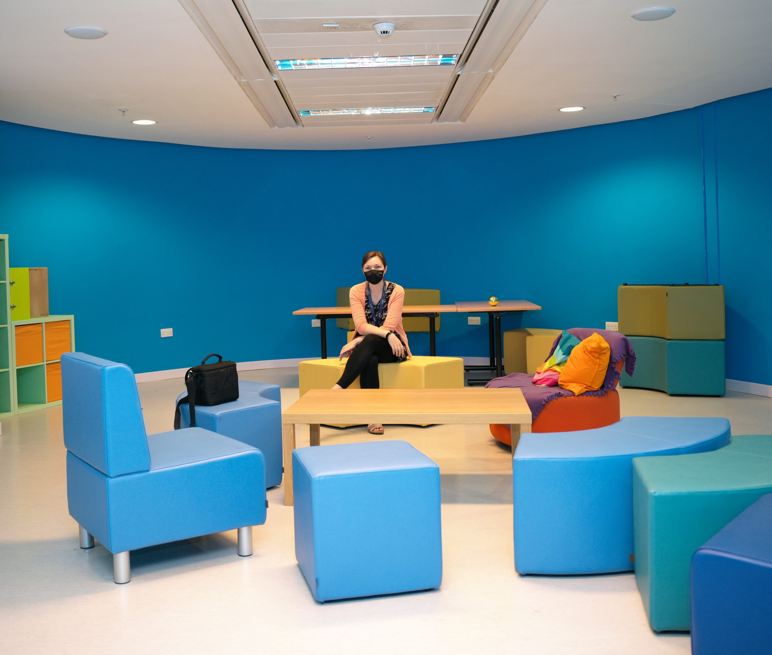
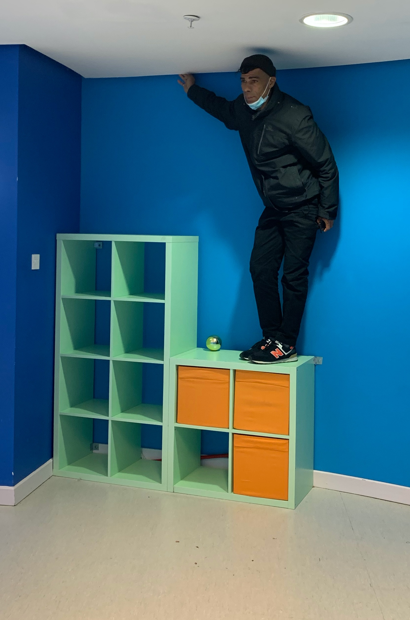
The egg showing the current ‘soft’ furniture
Possible void to allow for curtain hanging around the ceiling!

Slide 12
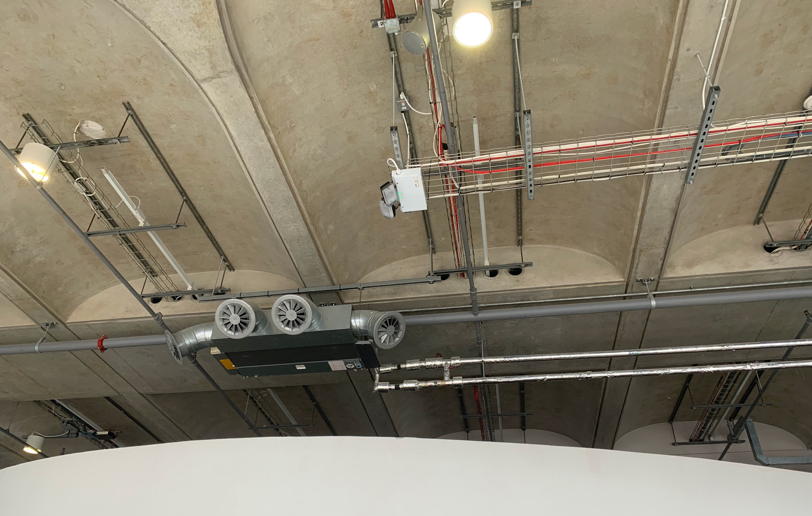
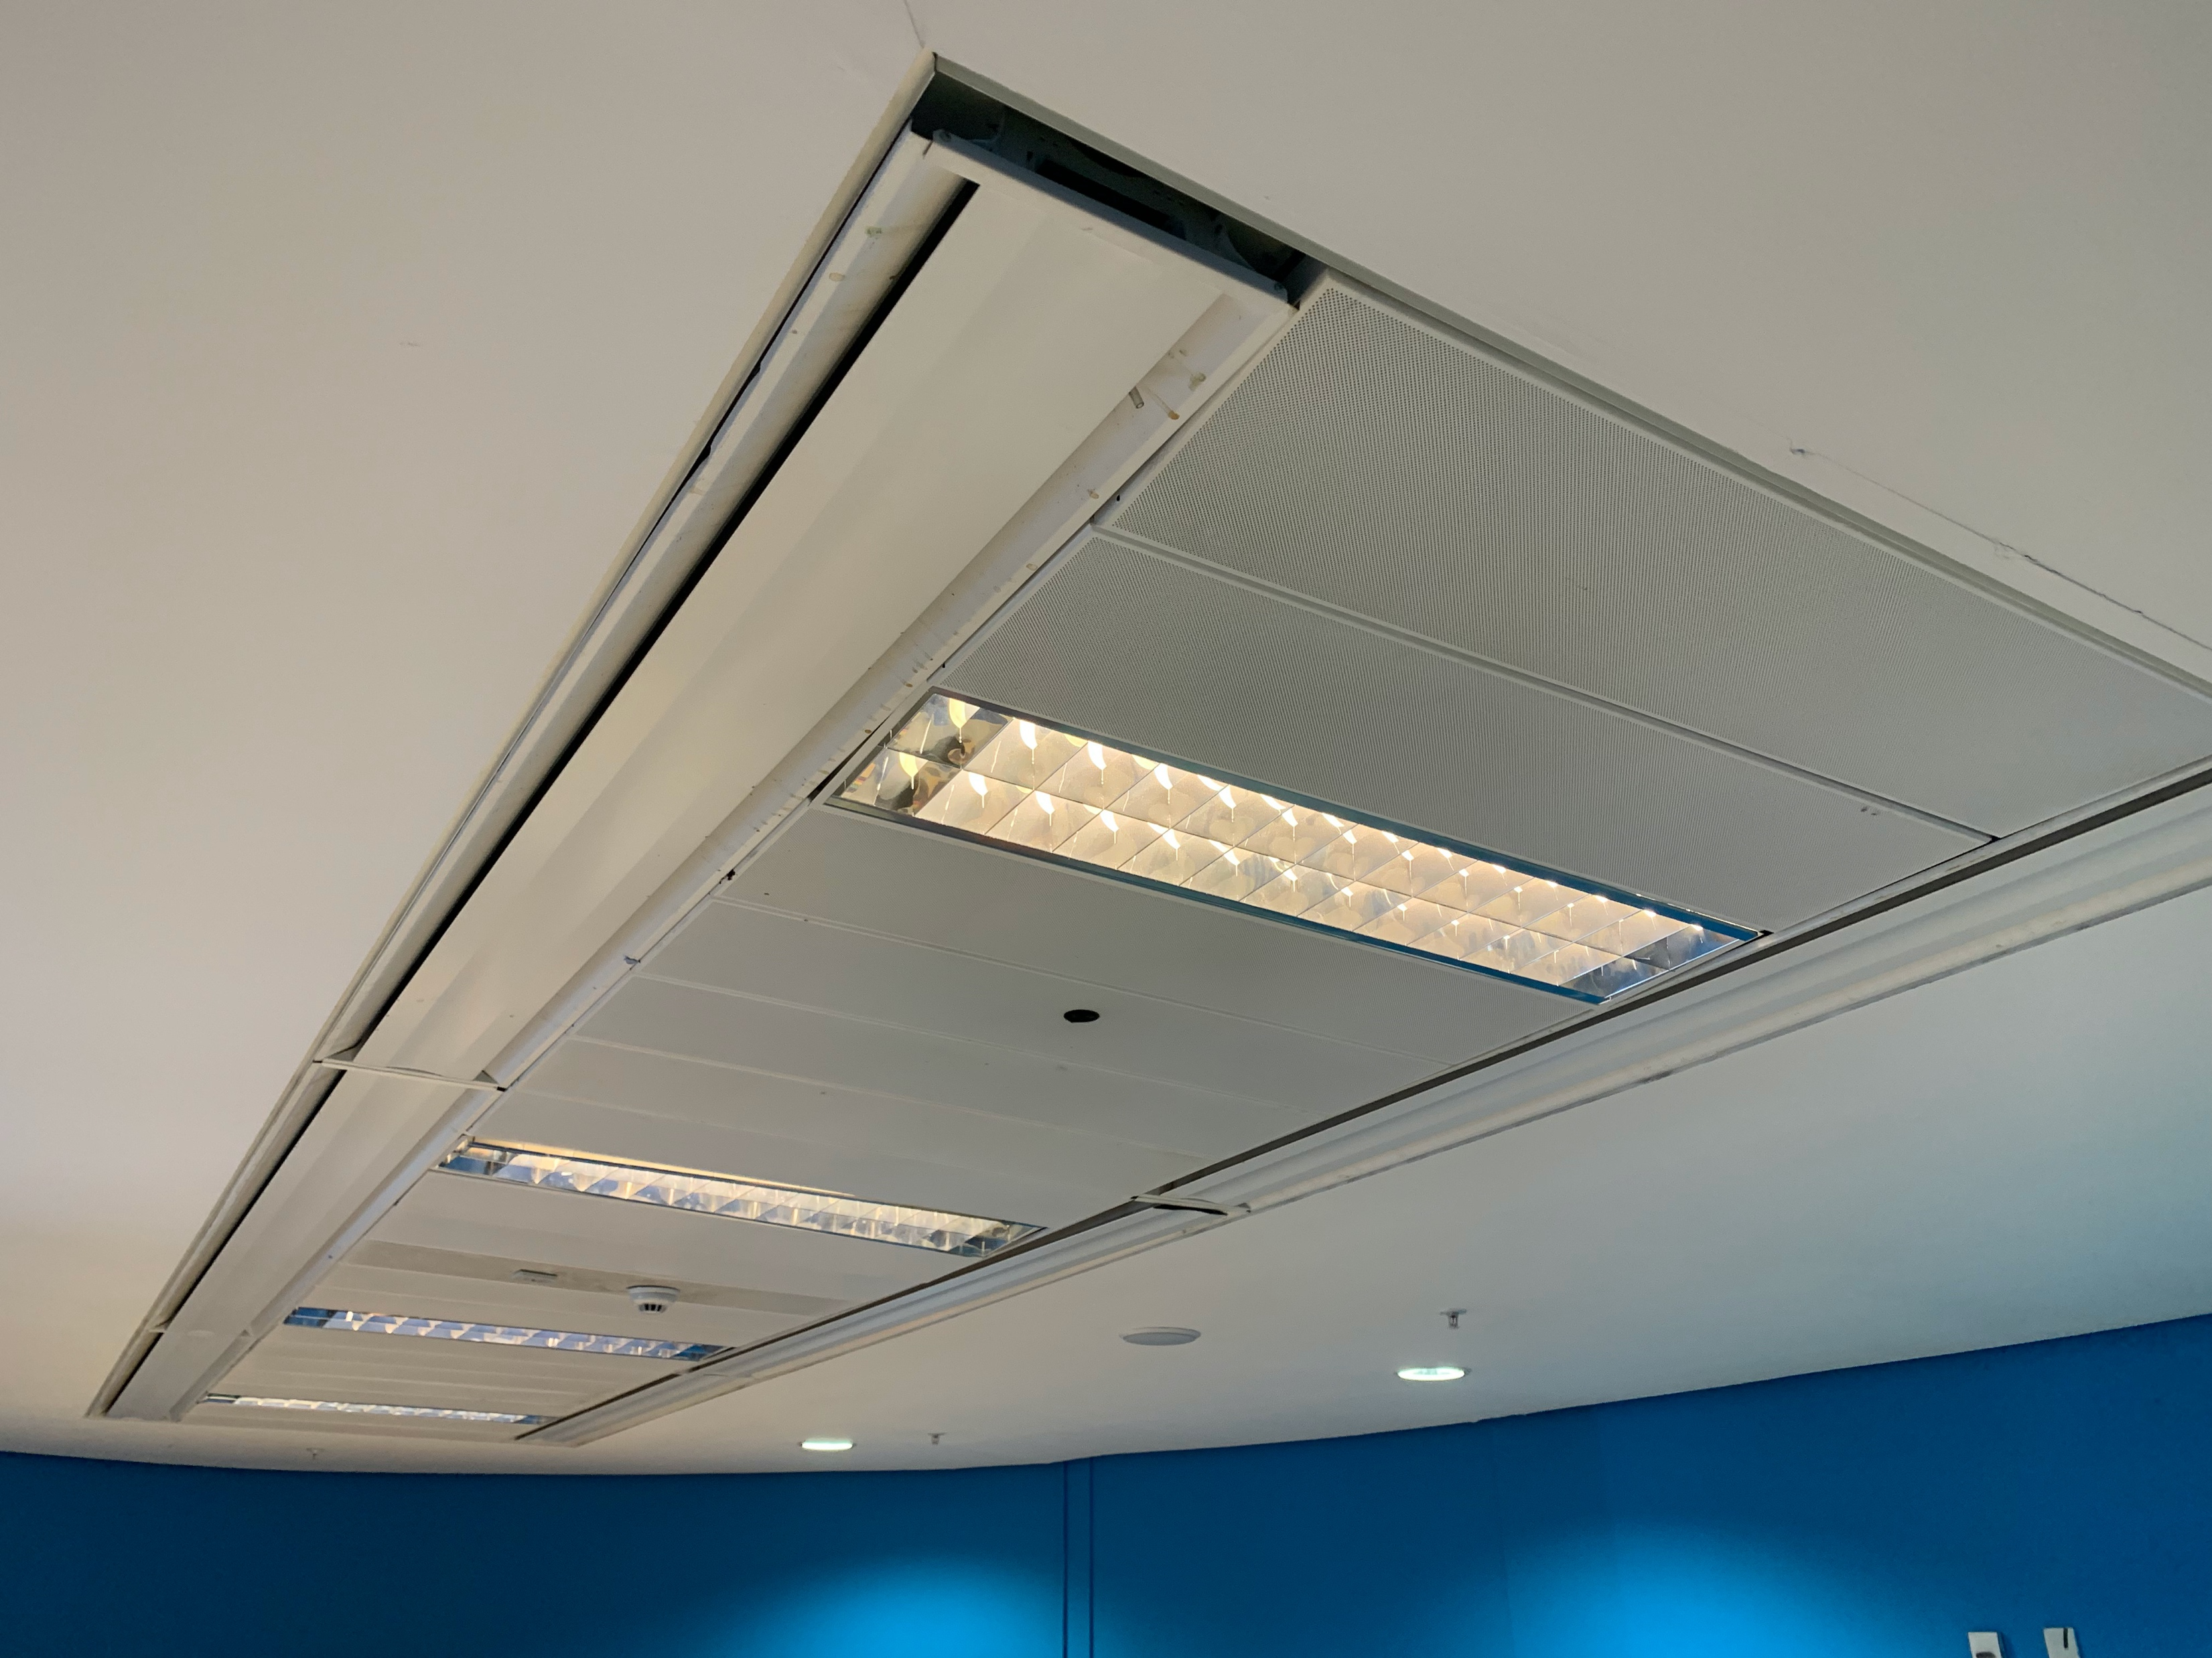
The concrete slab above the ceiling of the egg showing services.
The ceiling of the egg has not hanging capability, if required solutions would need investigation

Slide 13
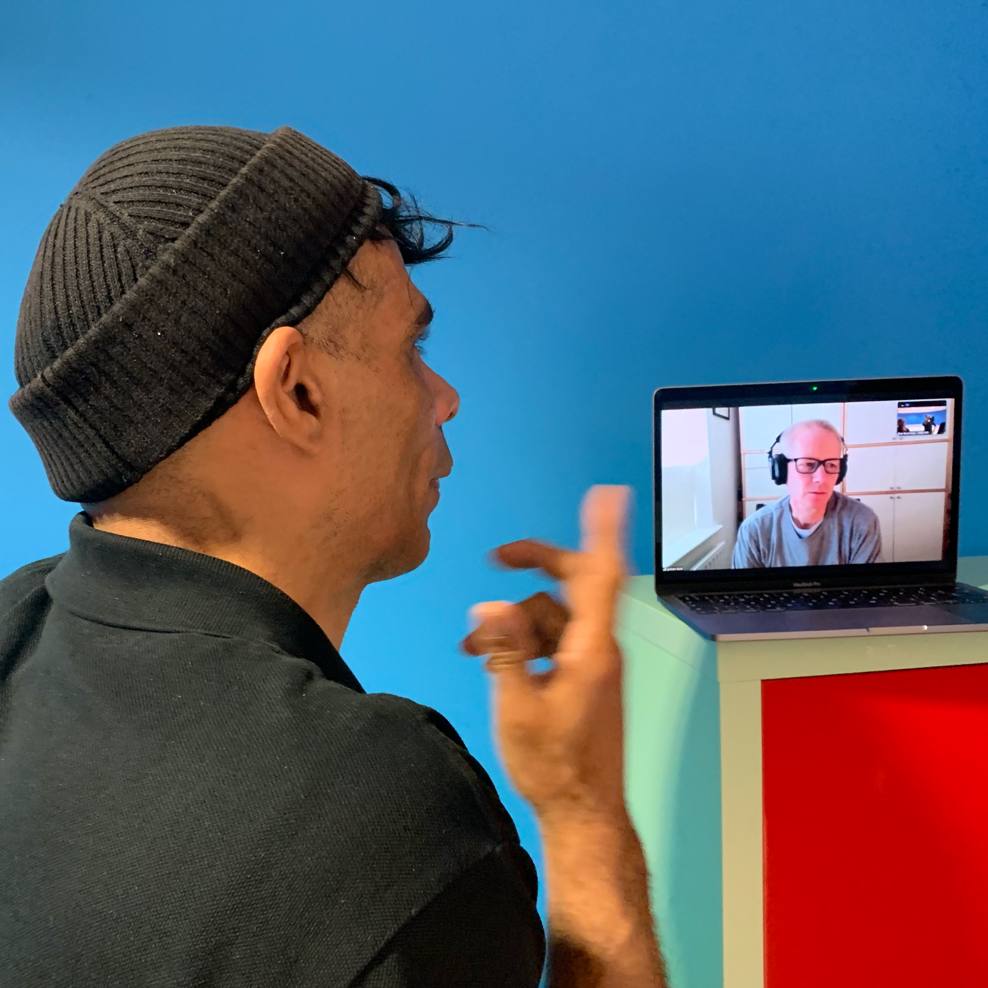
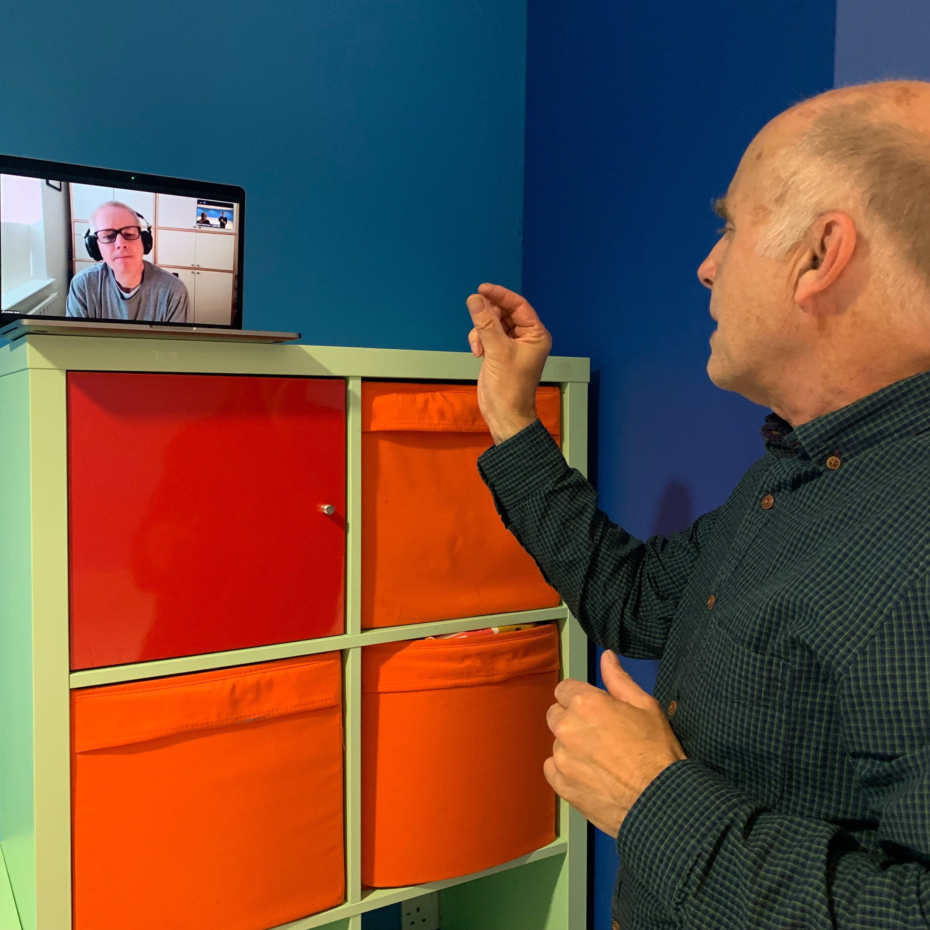

Slide 14
COP26 Polar Zero
‘1765’ sculpture and ‘Ice Core’ installation

Slide 15
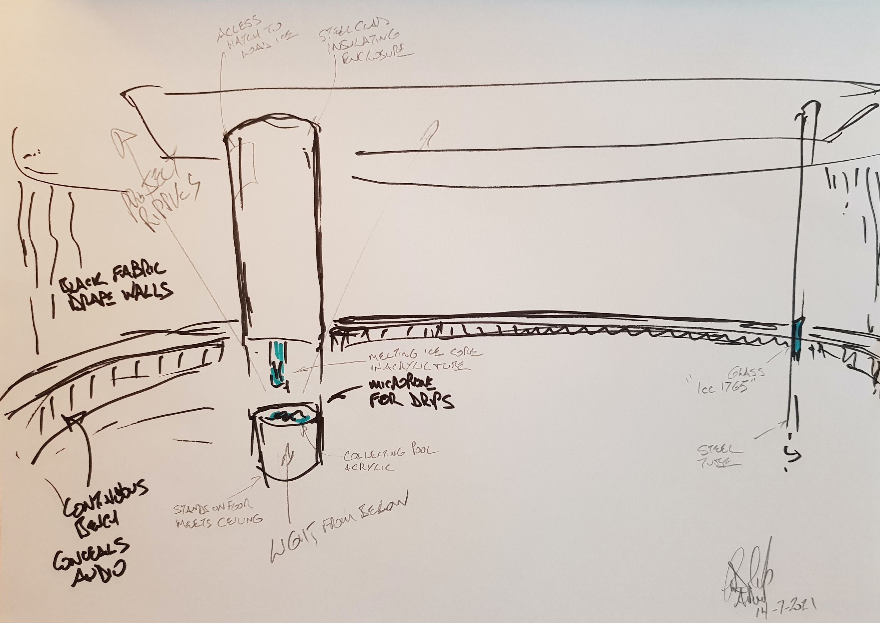
The egg - showing the two Polar Zero pieces
A sketch from Graham created during discussions - showing the two cylindrical forms of ‘Ice Core’ and ‘1765’ (both from floor to ceiling within the space)
Possible light onto ceiling through water
Black wall covering
Seating to follow the room form – & concealed audio?

Slide 16
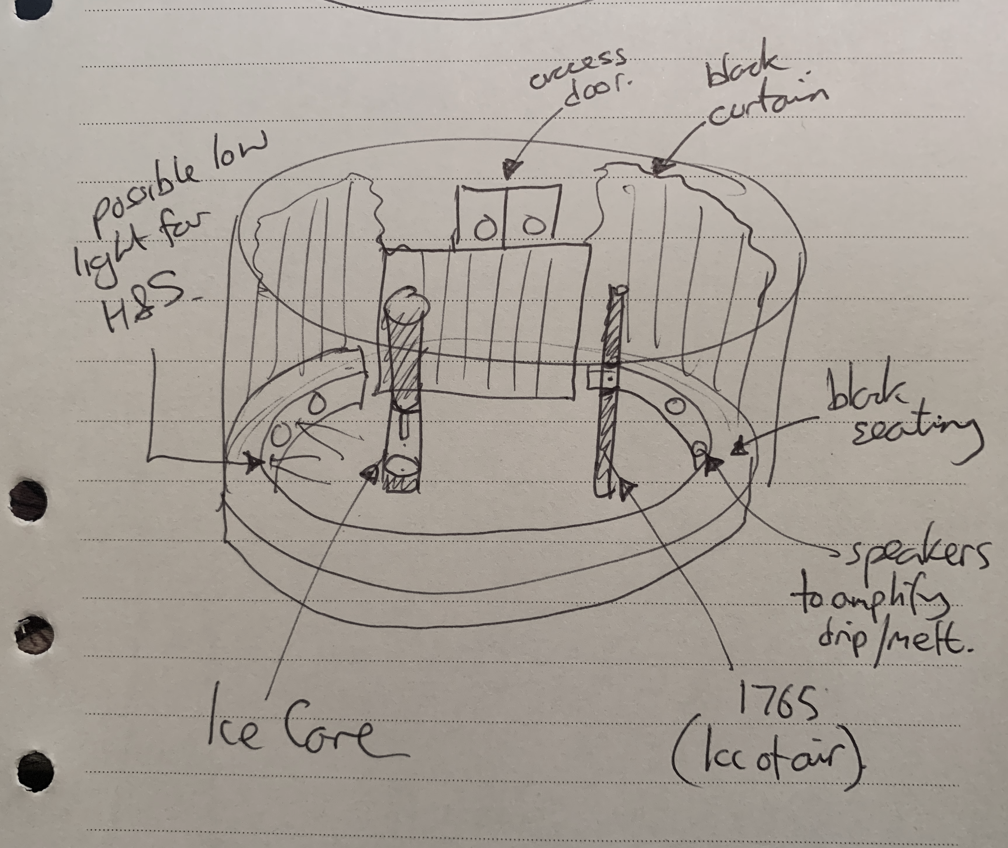
The egg exhibition space showing the two Polar Zero pieces
A sketch from Pete created during the discussions at the venue - showing the two cylindrical forms of ‘Ice Core’ and ‘1765’ (that both go from floor to ceiling within the space)
Black wall covering
Seating to follow the room form – with speakers & possibly low level light?

Slide 17
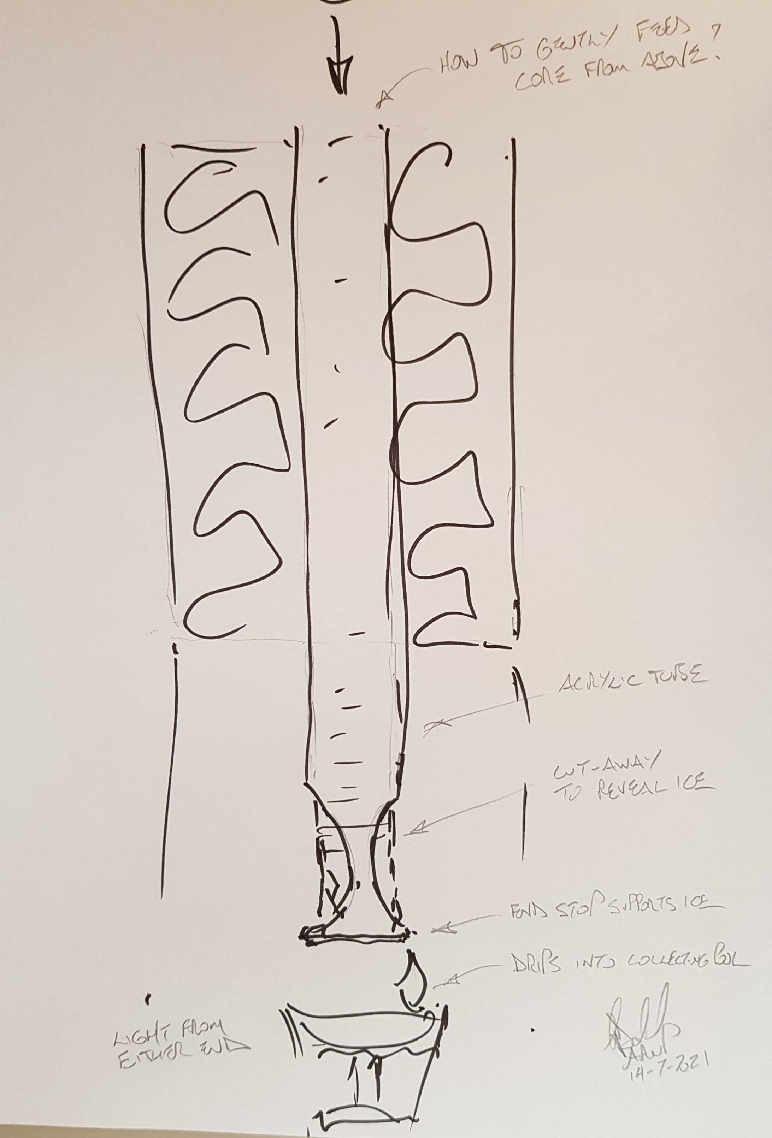
Polar Zero: ‘Ice Core’ Installation
A sketch from Graham created during the discussions at the venue - showing the installation concept.
Again this would be floor to ceiling. With components of the same diameter giving the overall cylindrical look.
At floor level a drip tray, above which the melting core appears from the insulated box
Sound (radio microphones) to amplify the sound of the melting core & drip
Ice Cores replenished as they melt from above or via a window in the insulated form?
Liquid captured for Wayne

Slide 18
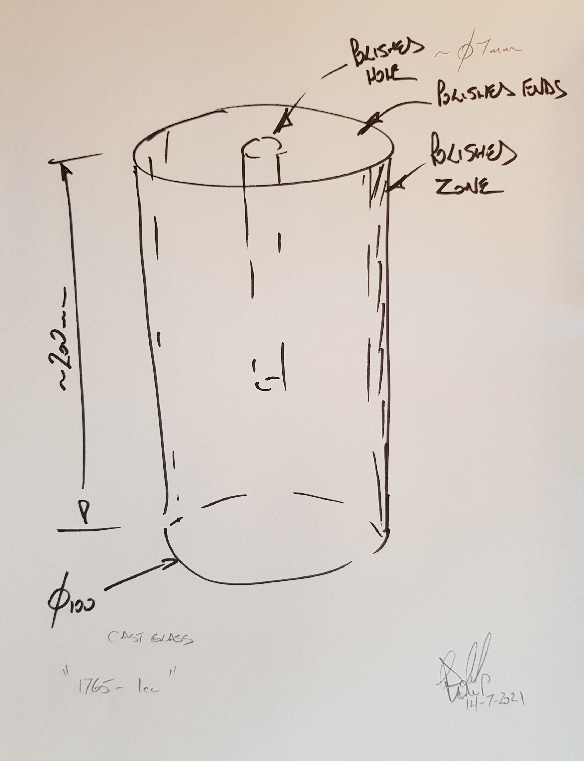
Polar Zero: ‘1765’ 1cc of air
A sketch from Graham created during the discussions at the venue - showing the cylindrical form.
Frosted with polished ends and stripe/zone down opposite sides, so that the bubble can be seen
This would sit within a metal tube standing floor to ceiling.
The piece lit from the ends/inside the tube!

Slide 19
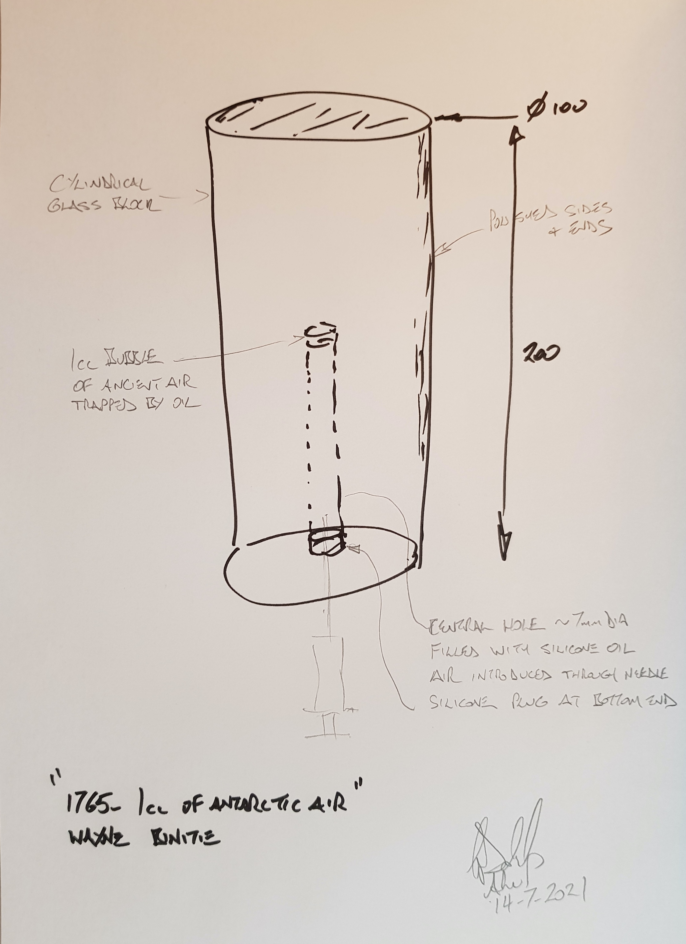
Polar Zero: ‘1765’ 1cc of air
A sketch from Graham created during the discussions at the venue - showing the cylindrical form.
Frosted with polished ends and stripe/zone down opposite sides, so that the bubble can be seen
This would sit, visually as a section of a metal tube, standing floor to ceiling.
The piece lit from the ends/inside the tube!

Slide 20
COP26 Polar Zero
Ice Stories

Slide 21
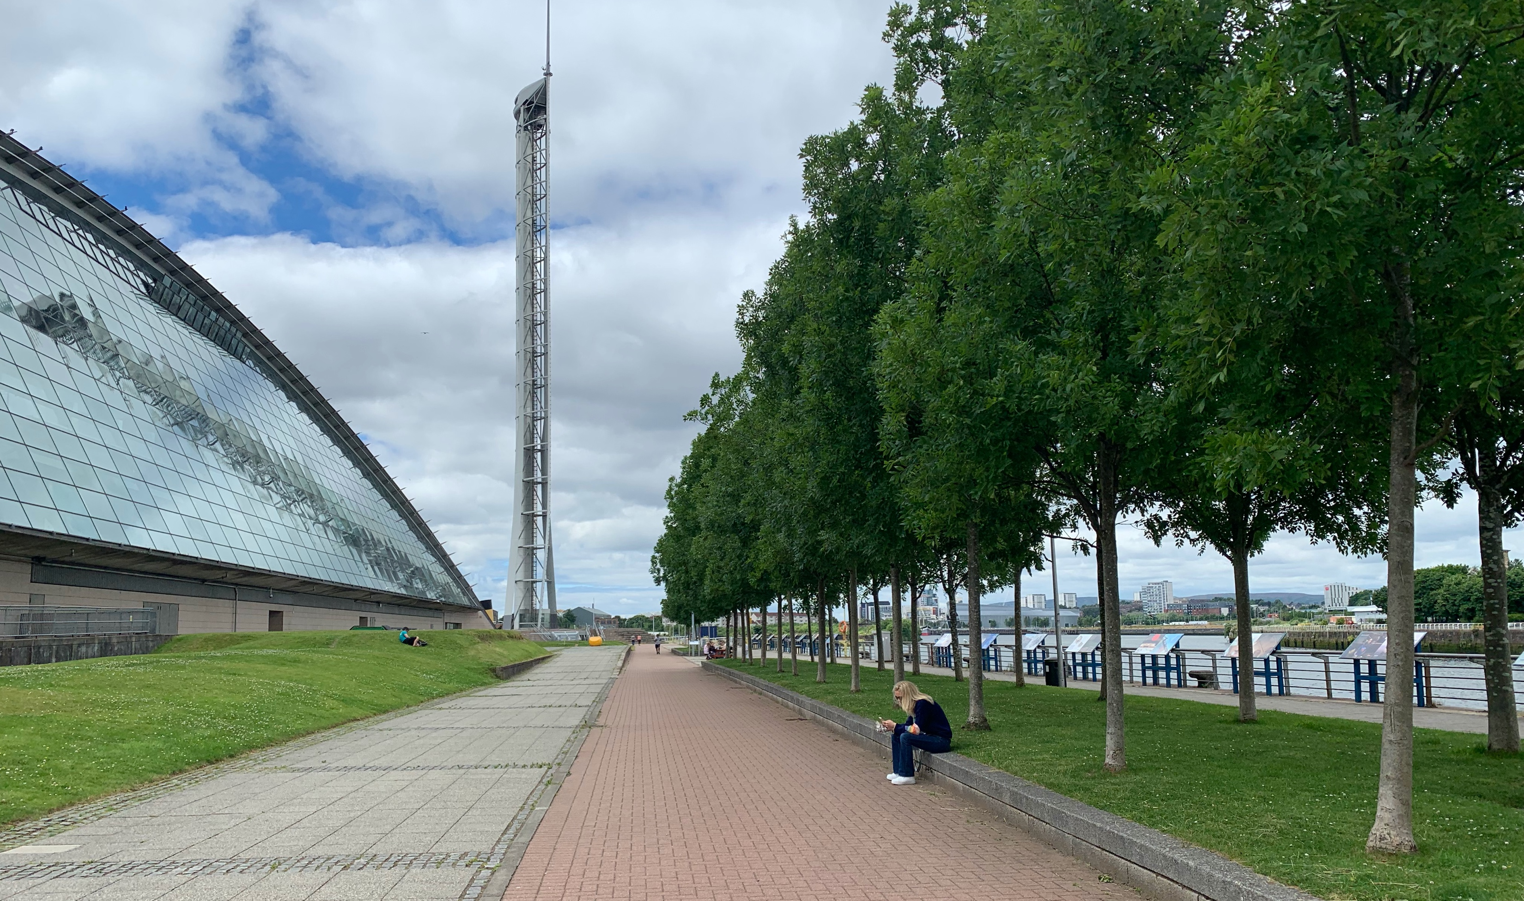
pedestrian walkway between the GSC and the Clyde showing low wall/seat that could be used for ‘Ice Stories’

Slide 22
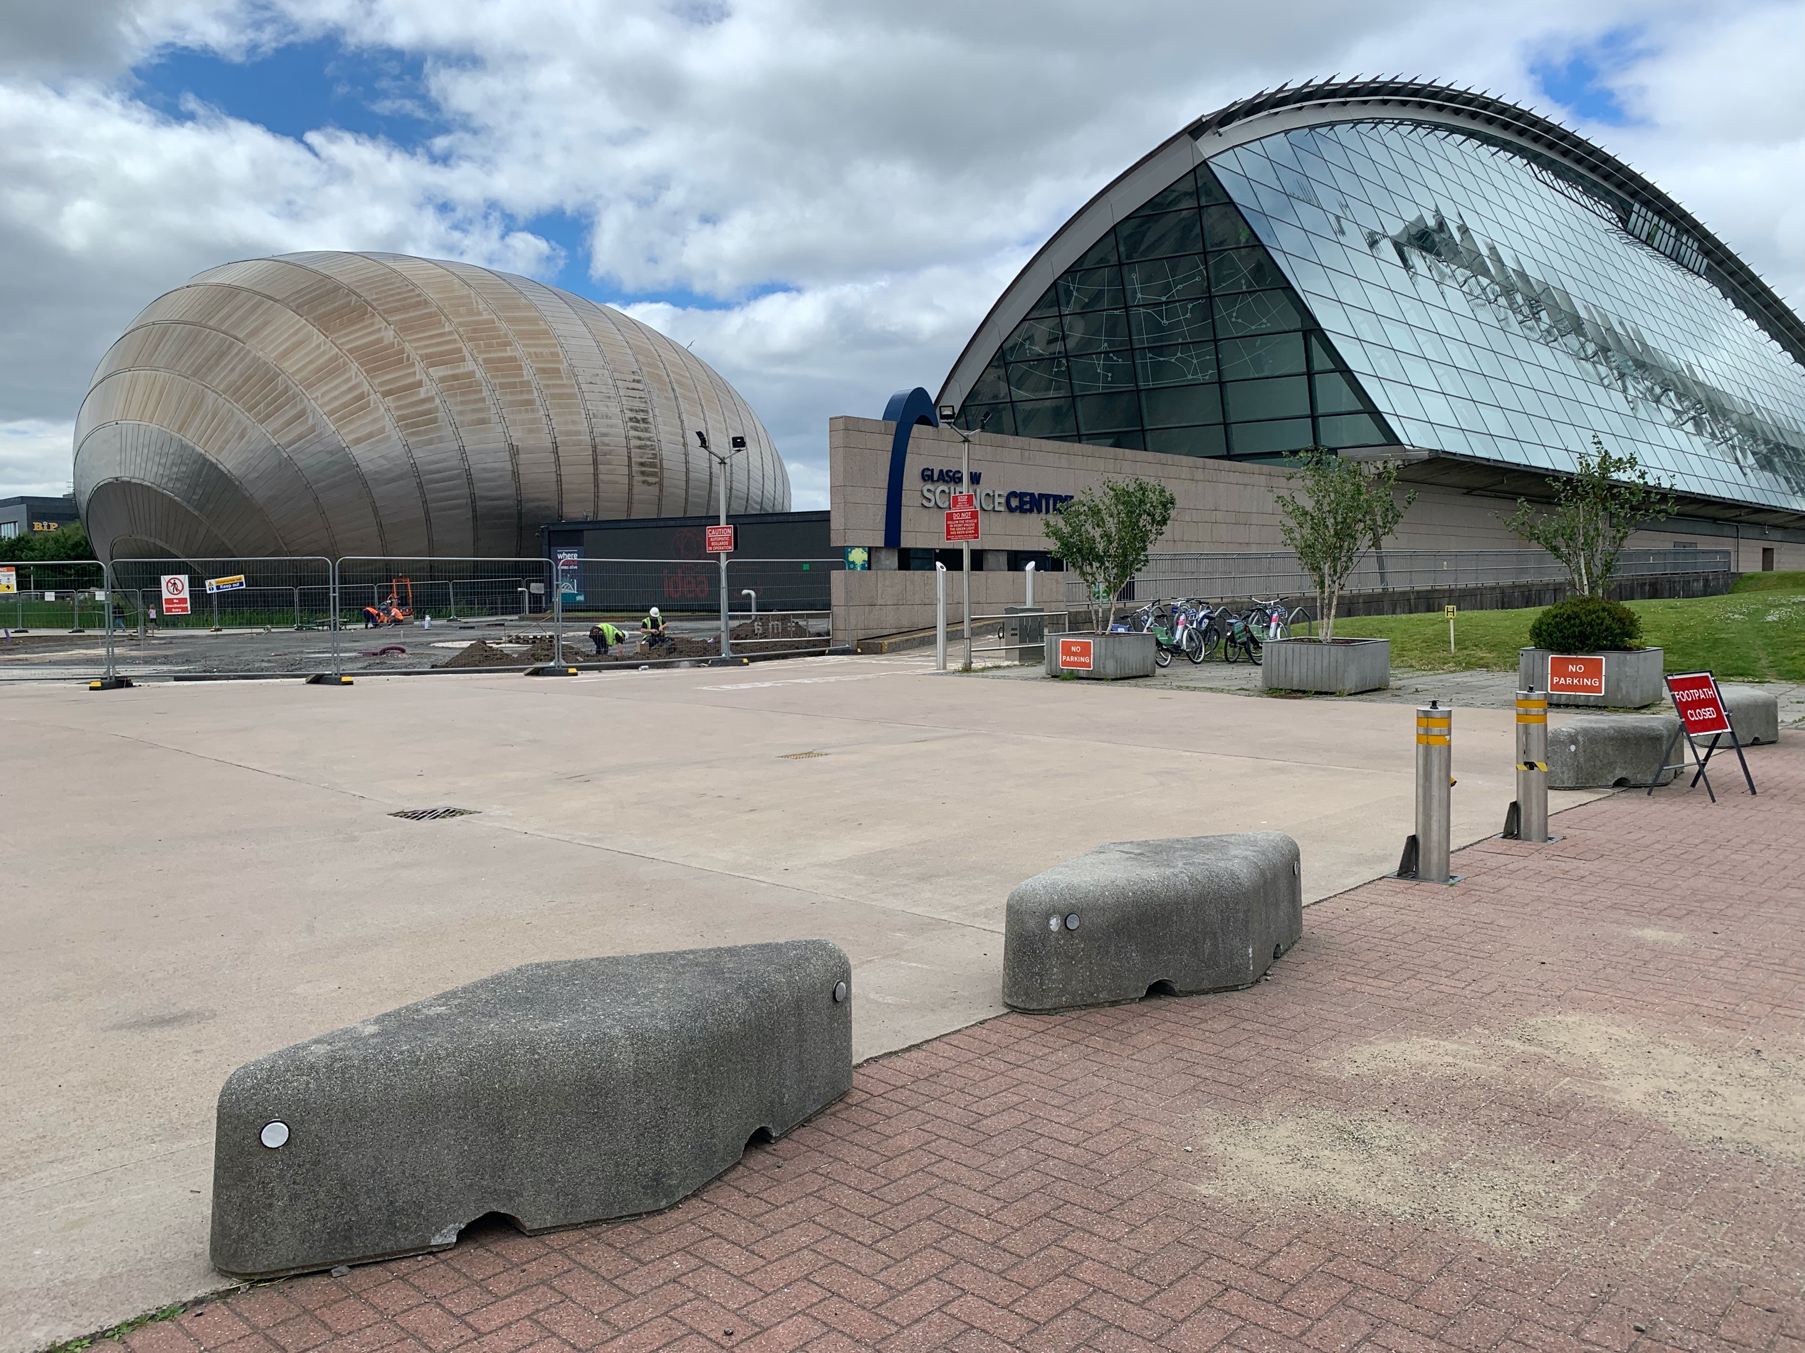
Example movable concrete ‘lozenges’ that could be used for ‘Ice Stories’ around the pedestrian areas

Slide 23
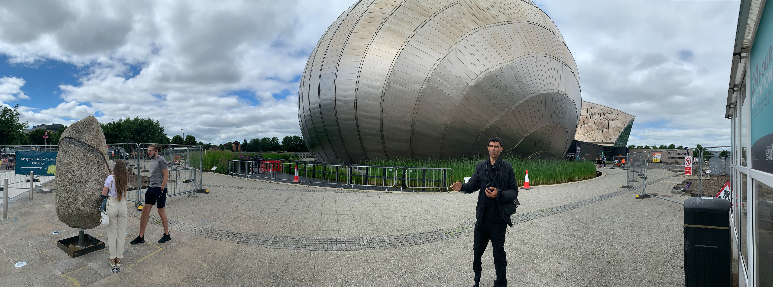
The walkway between carpark and access doors could be used for ‘Ice Stories’

Slide 24
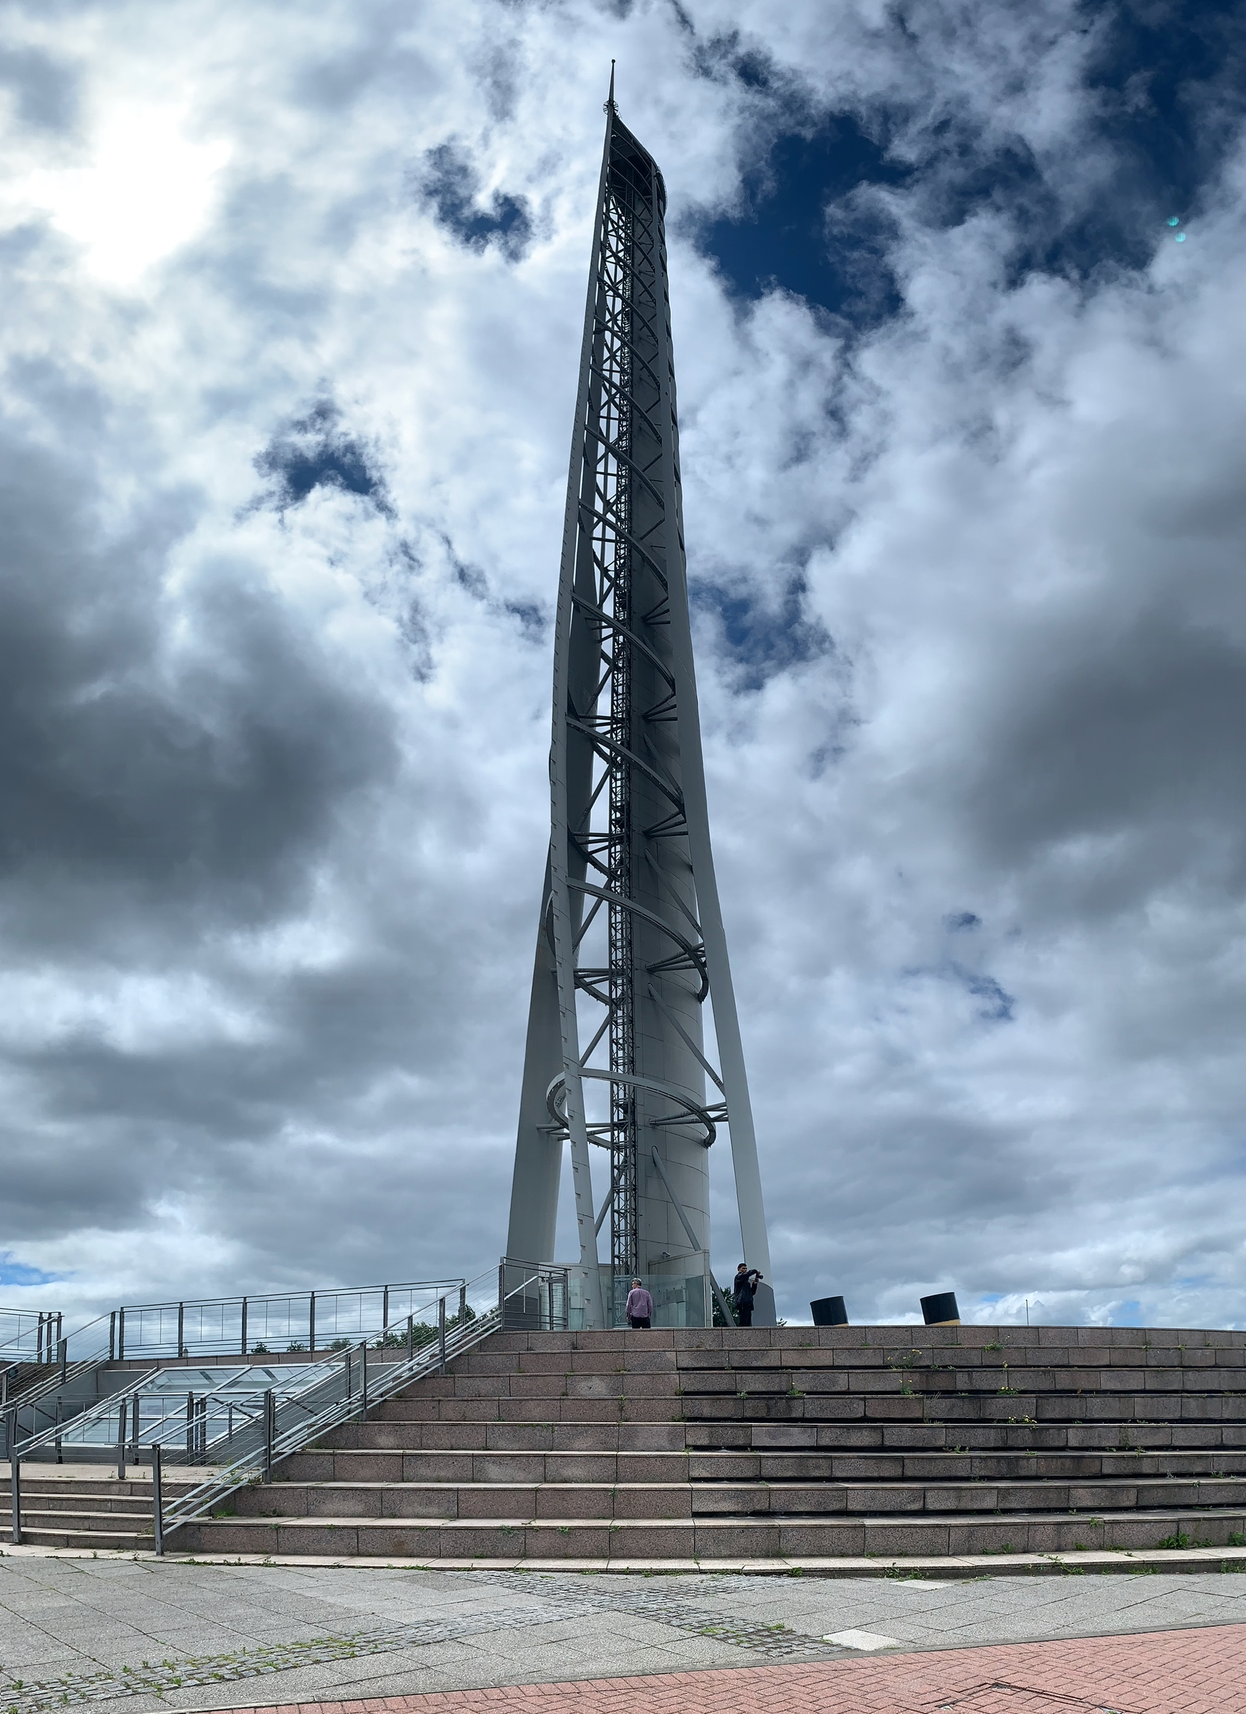
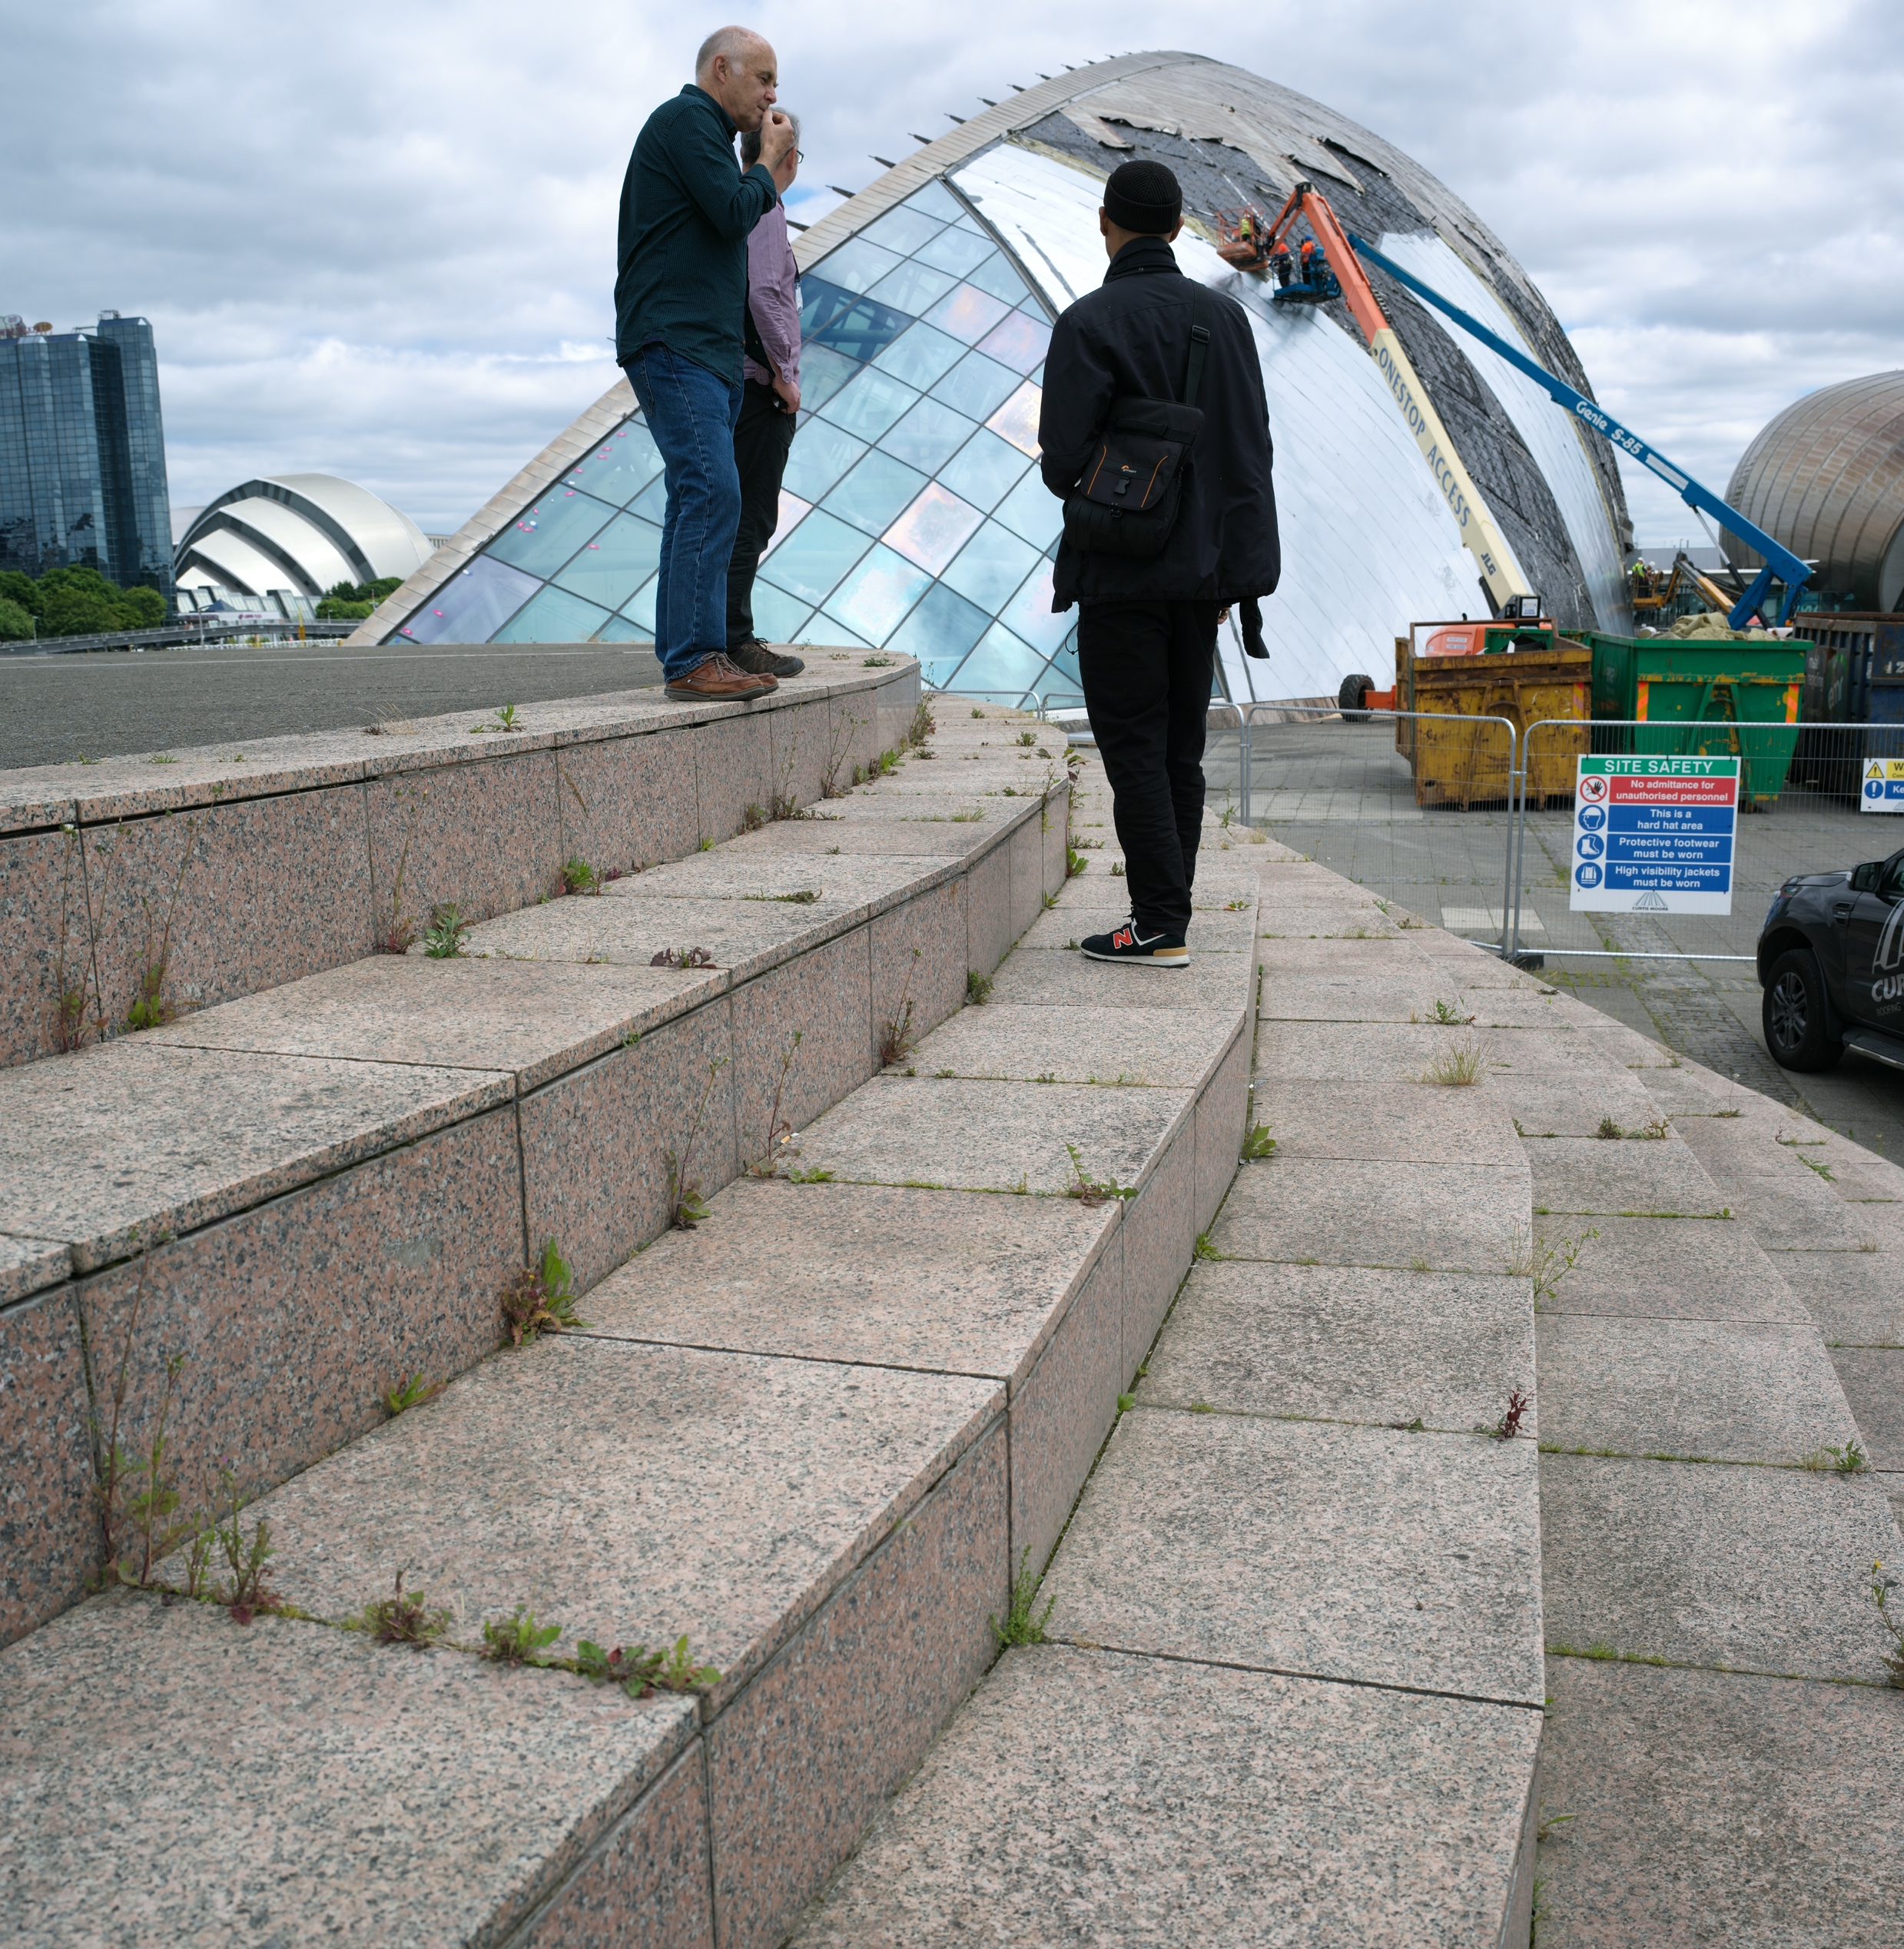
pedestrian area steps around the observation tower could be used for ‘Ice Stories’

